Slide 1
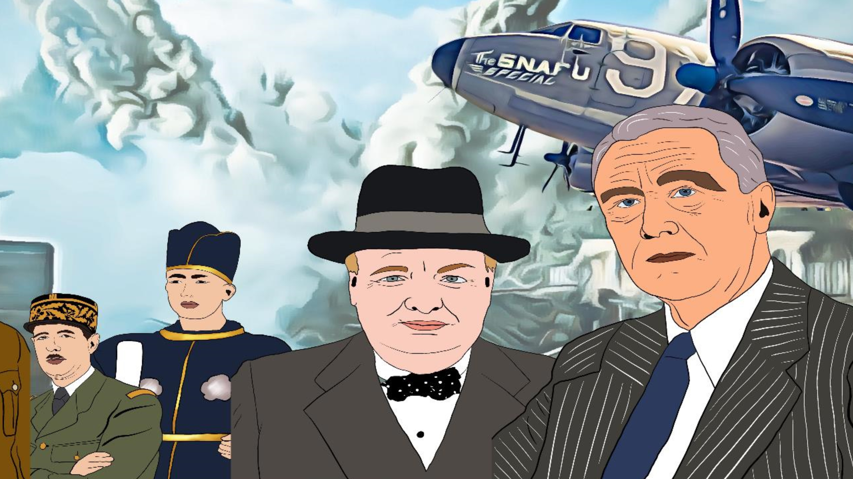



WORLD WAR II
CURRICULUM
+ EDITABLE VERSION

Slide 2

Hi, I'm Manuela
Just like you, an educator who truly understands the daily hurdles we encounter in our classrooms.
Finding engaging resources that meet all students' needs can be a struggle, and planning lessons takes up valuable time. That's why I'm here to provide high-quality, ready-to-use teaching resources that save you time and effort.
With my captivating products, you can focus on inspiring your students and enjoy the teaching journey.

Slide 3
I've created this editable curriculum designed to save you time and energize your classroom.
Feel free to click on the images or hyperlinks to explore the materials and get a taste of what's in store. With my curriculum, you'll have everything you need to captivate your students and make learning enjoyable.
My curriculum offers a range of ideas and inspiration to elevate your lessons. Whether or not you choose to purchase my additional resources, you'll find a wealth of activities to enrich your teaching. From analyzing primary
sources to creating charts, conducting research, or delivering multimedia presentations, these suggestions will bring variety and depth to your classroom. You're in control of how you implement the curriculum, making it a flexible tool that aligns with your teaching style.
So, dive in and explore the possibilities! Your students will thank you for the engaging and dynamic learning experience. Let's embark on this exciting journey together!
TIPS FOR TEACHERS
Manuela

Slide 4
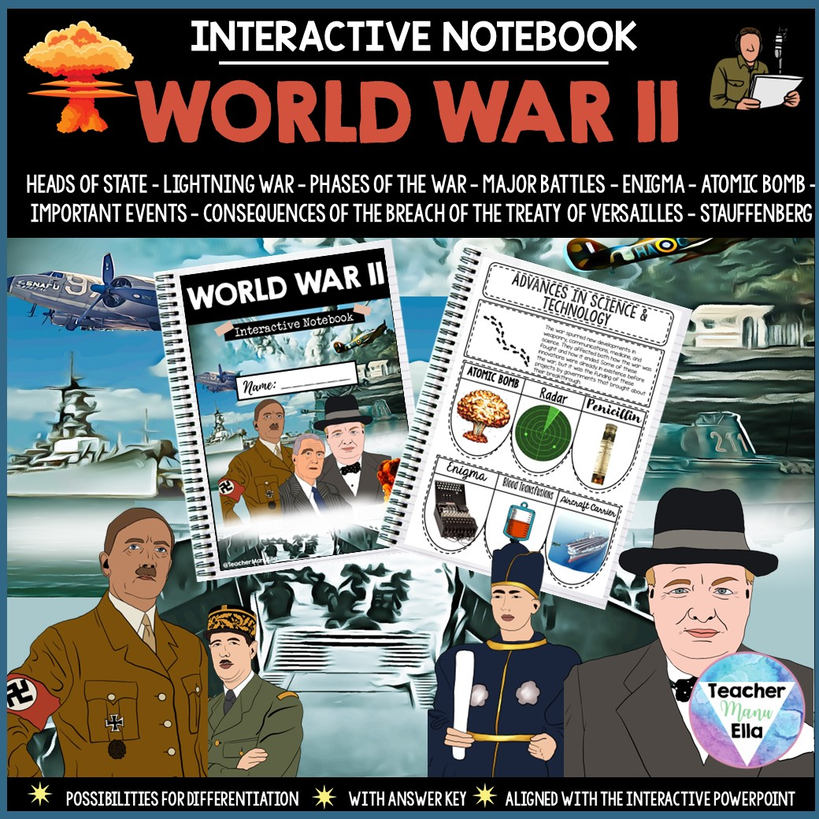
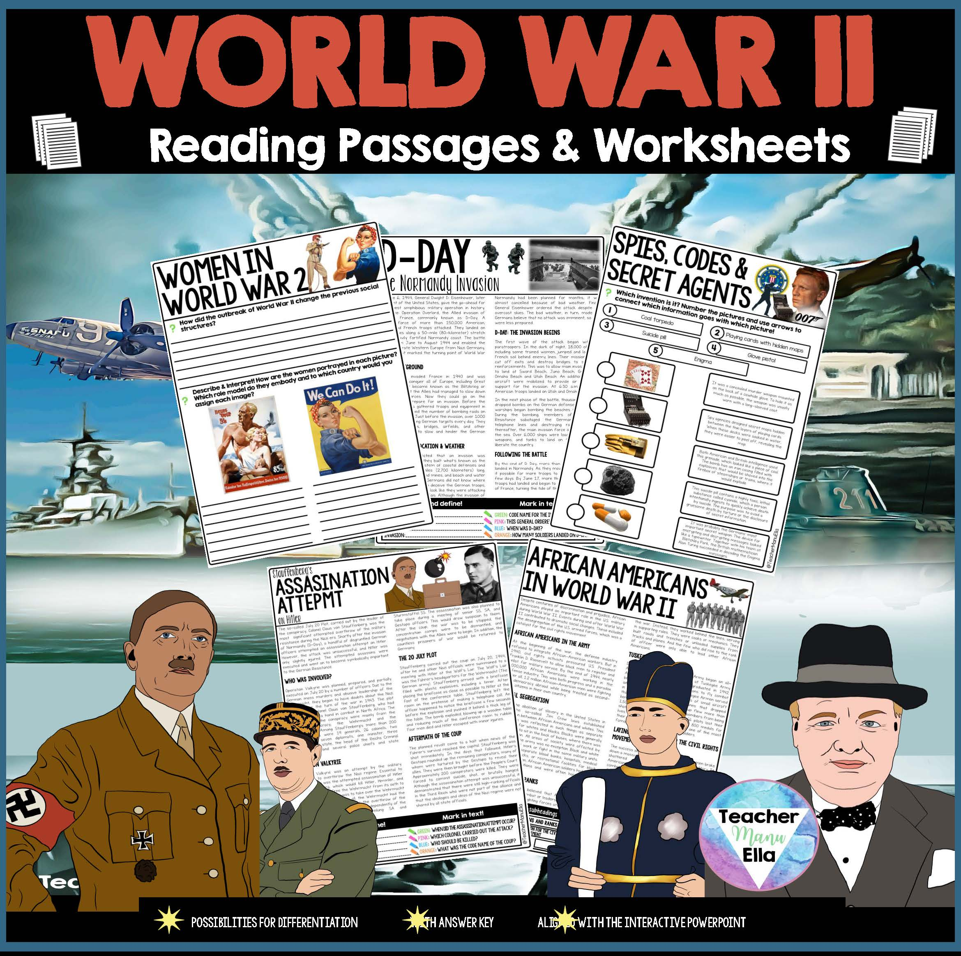
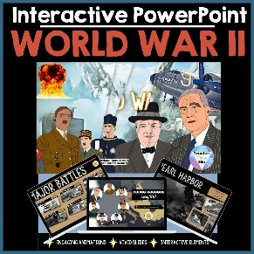
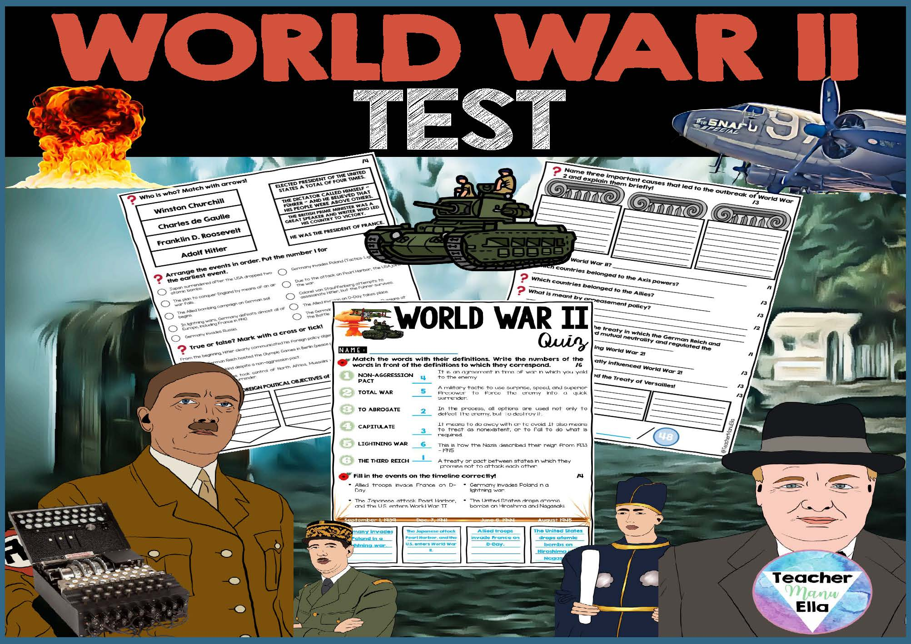
HOW IT WORKS
Each topic I cover is BUNDLED into a ready-to-use package, usually comprising 4 essential materials:
With this aligned approach, your students will have a cohesive and comprehensive learning experience. They can find the solutions they need for the Interactive Notebook in the interactive and visually rich content of the PowerPoint. HOWEVER, you'll find a variety of activities that will enhance your teaching experience whether you choose to purchase my additional resources or not.
Interactive Notebook: Engage your students with visually appealing and interactive notebook pages that perfectly align with the content covered in the accompanying Interactive PowerPoint.
Interactive PowerPoint: Deliver dynamic and engaging presentations that not only provide information but also guide students to find the solutions they need within the Interactive Notebook.
Reading Passages and Worksheets: Deepen students' understanding with carefully crafted reading passages and accompanying worksheets that reinforce
the concepts covered.
Test and Assessment: Evaluate your students' learning and track their
progress with pre-made tests and assessments that align seamlessly
with the curriculum.

Slide 5
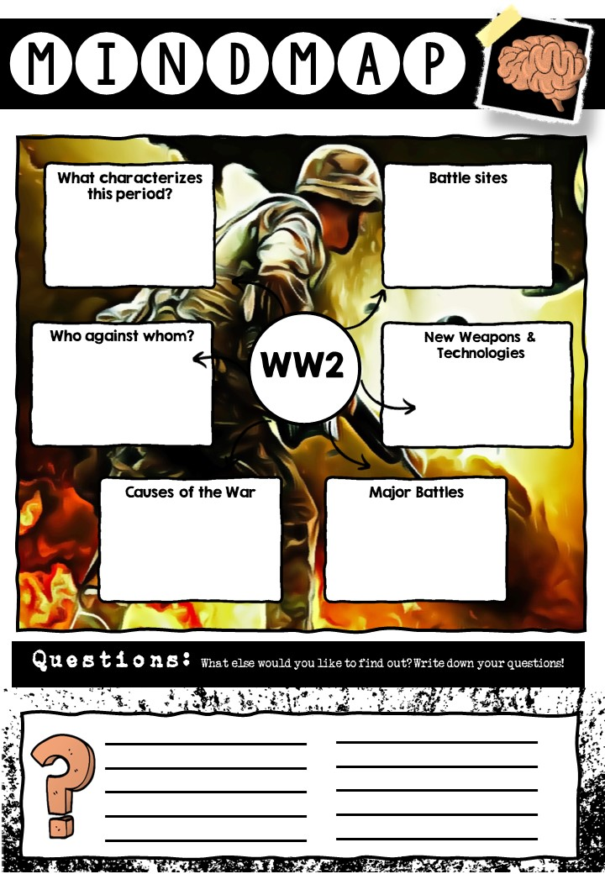

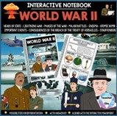
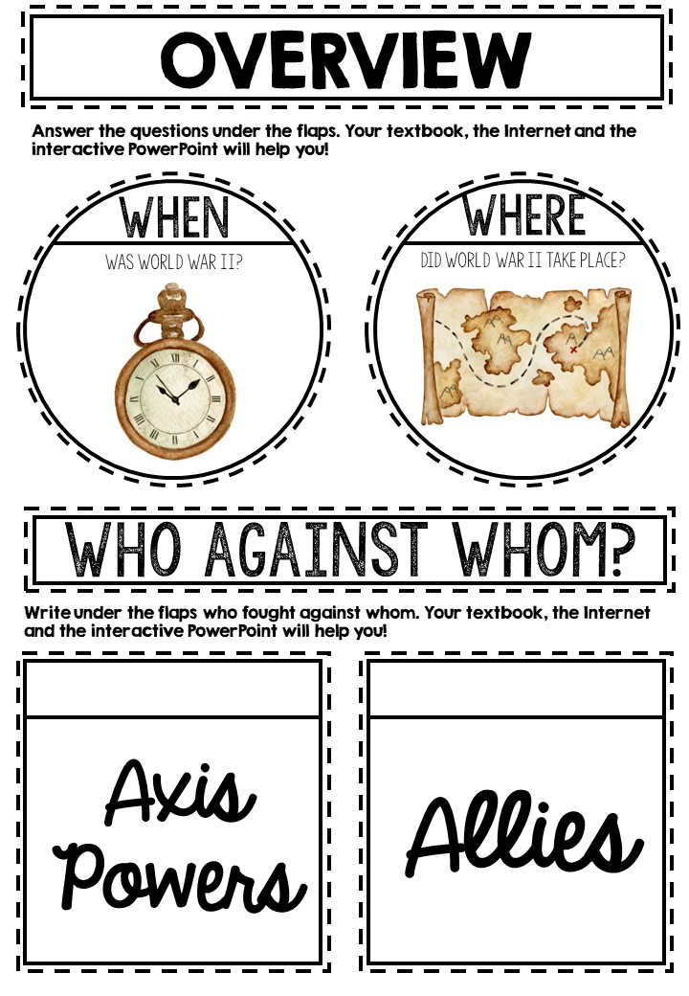
WEEK I: WORLD WAR II CURRICULUM
RESOURCES | TOPIC AND RESOURCE PREVIEWS | ACTIVITY | ASSESSMENT | ADDITIONAL NOTES
 | Overview When, Where, Who vs. Whom Brainstorming |  |  | Set the foundation by providing an overview of the war, including the timeline, key locations, and the main warring nations
 |  | Brainstorming: Engage students in a brainstorming session to gather their prior knowledge and ideas about World War II |  | Brainstorm the causes of World War II and create a mind map in your interactive notebook to visually organize the key factors.
 |  | Interactive PowerPoint: Students use the provided interactive PowerPoint to explore and gather information for the overview topic | Students click through the interactive PowerPoint to find out more. | Students actively engage with the interactive PowerPoint to learn about the overview of World War II
 |  | Interactive Notebook: Students use the information from the interactive PowerPoint to complete the corresponding section in their notebook | Teacher assessment of completed notebook section | Students transfer the gathered information from the interactive PowerPoint to their notebooks, reinforcing their understanding
 |  | Other Ideas: Analyze primary sources related to major events during World War II | Presentation or written analysis | Engage students in analyzing primary sources such as speeches, letters, or photographs to gain deeper insights into the events of World War II

Slide 6
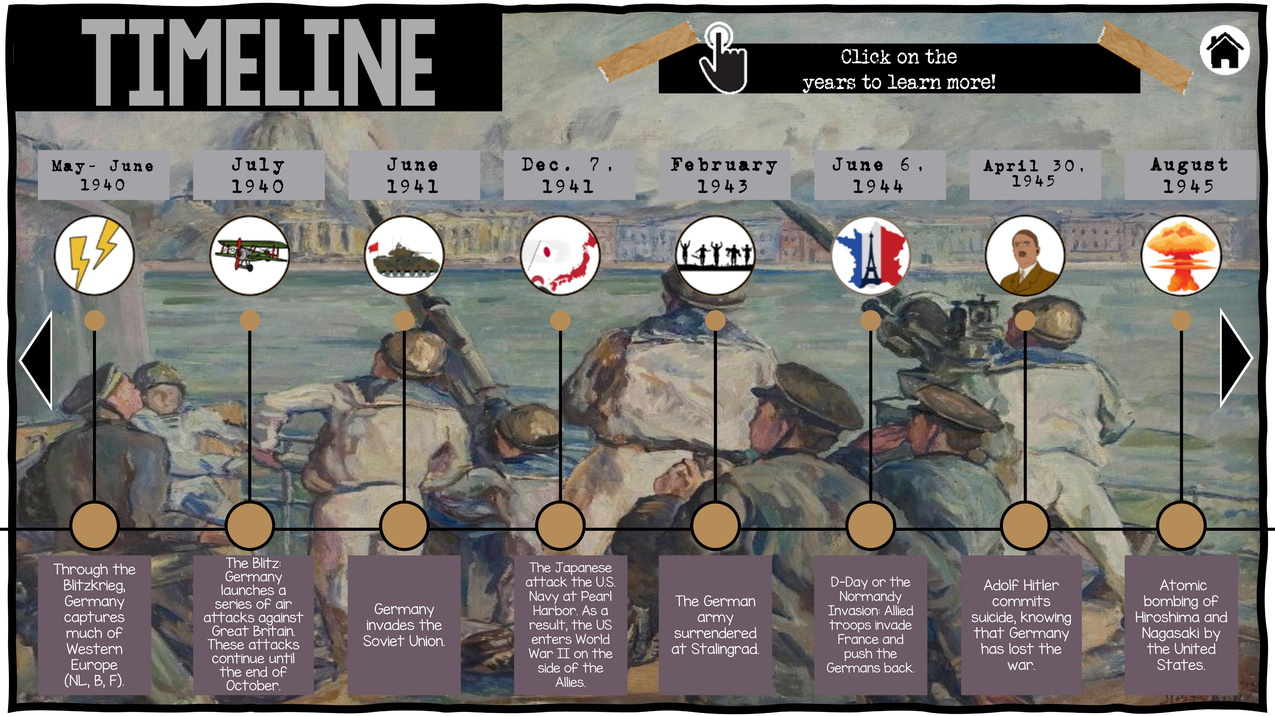
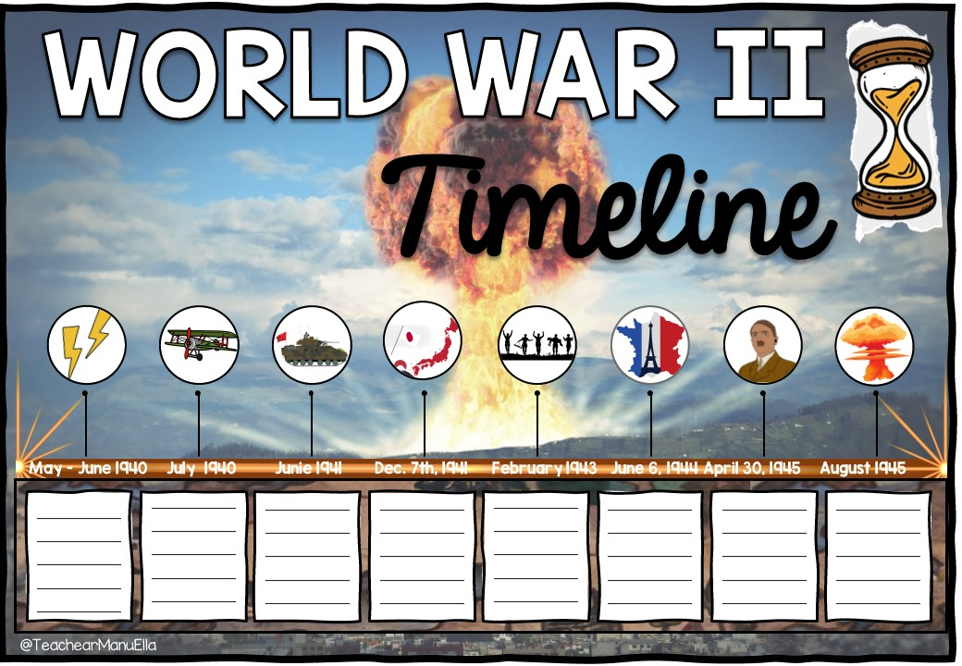
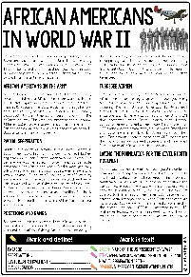
WEEK 2: WORLD WAR II CURRICULUM
RESOURCES | TOPIC AND RESOURCE PREVIEWS | ACTIVITY | ASSESSMENT | ADDITIONAL NOTES
 | Timeline & Important Events | Introduction |  | Set the foundation by providing an overview of the war, including the timeline, key locations, and the main belligerent nations
 |  | Interactive PowerPoint: Students use the interactive PowerPoint to explore and gather information for the timeline topic | Students click through the interactive PowerPoint to find out more. | Students actively engage with the interactive PowerPoint to learn about the significant events during World War II
 |  | Interactive Notebook: Students use the information from the interactive PowerPoint to complete the corresponding section in their notebook | Teacher assessment of completed notebook section | Students transfer the gathered information from the interactive PowerPoint to their notebooks, reinforcing their knowledge of the timeline
 |  | Reading Passage: African Americans in the 2nd World War | Comprehension questions on the worksheets included and/or class discussion | This text focuses specifically focusing on the contributions and experiences of African Americans during World War II
 |  | Other Ideas: Analyze primary sources related to major events during World War II | Presentation or written analysis | Engage students in analyzing primary sources such as speeches, letters, or photographs to gain deeper insights into the events of World War II

Slide 7
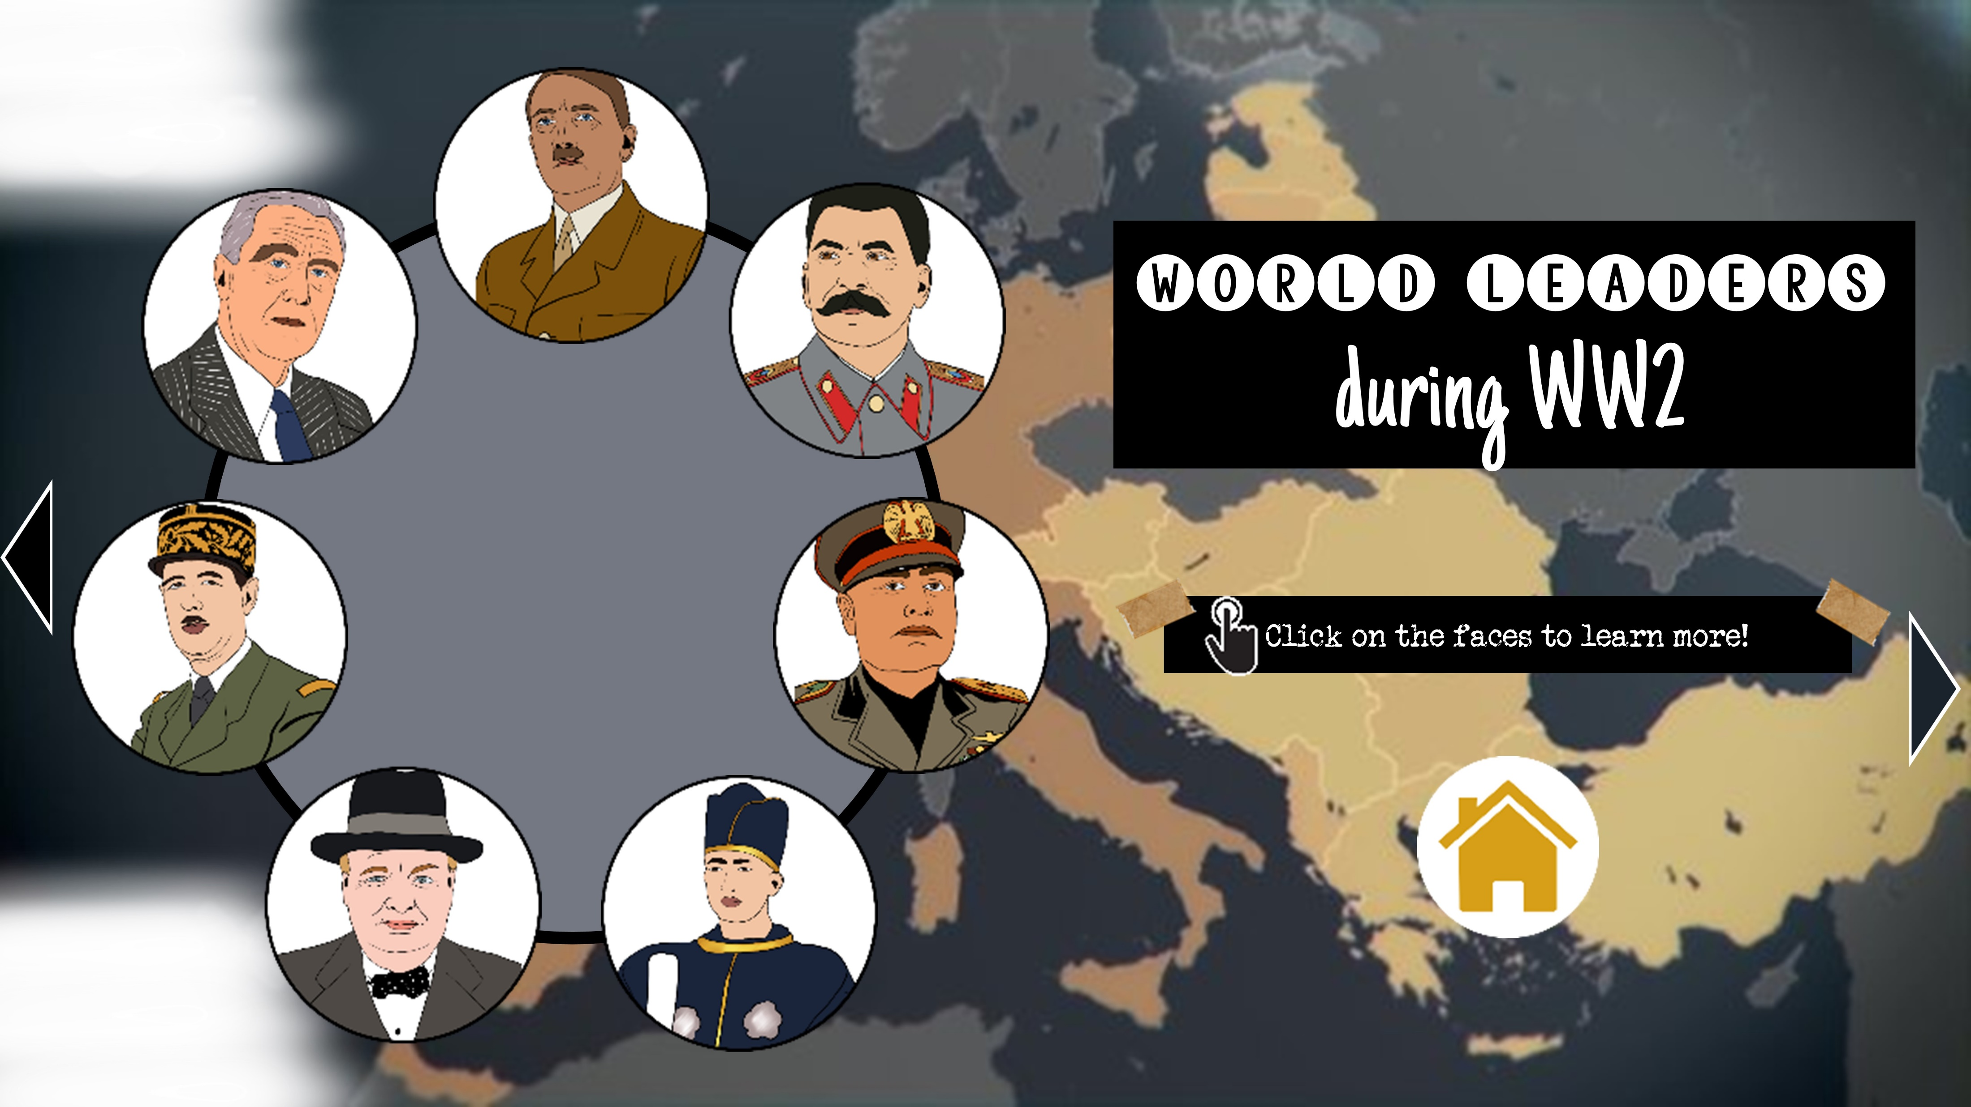
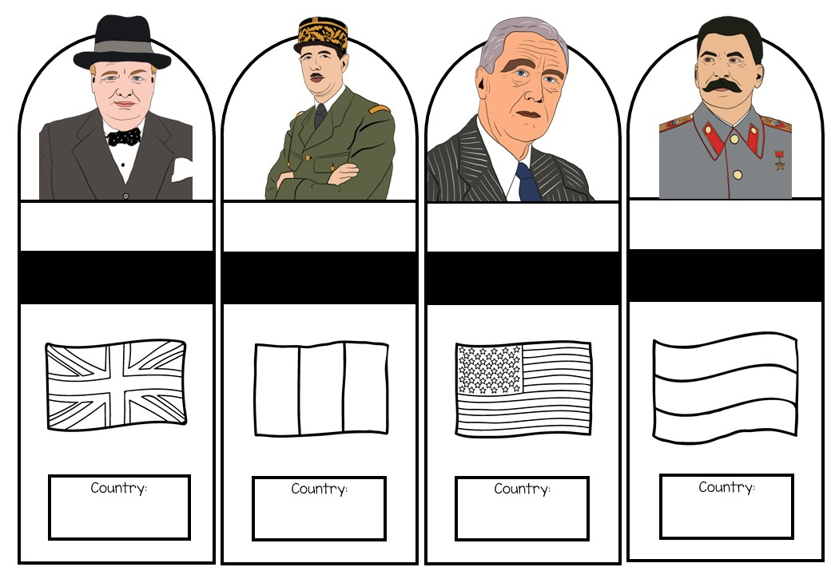
WEEK 3: WORLD WAR II CURRICULUM
RESOURCES | TOPIC AND RESOURCE PREVIEWS | ACTIVITY | ASSESSMENT | ADDITIONAL NOTES
 | World Leaders: Hitler, Mussolini, Hirohito, Churchill, de Gaulle, Roosevelt, Stalin | Review Activity / Bell Ringer: "World War II Timeline Quiz | Classroom Setting | Quiz students about the important dates and events from World War II to review the topic from the last week.
 |  | Interactive PowerPoint: Students use the interactive PowerPoint to explore the world leaders during World War II and they learn who belonged to which country. | Completion of the interactive PowerPoint | Students engage with the interactive PowerPoint
 |  | Interactive Notebook: Students use the information from the interactive PowerPoint to complete the corresponding section in their notebook | Teacher assessment of completed notebook section | Students transfer the gathered information from the interactive PowerPoint to their notebooks, reinforcing their knowledge
 |  | Other Ideas: Create a multimedia presentation on the major leaders of World War II | Multimedia presentation | Assign each student a major leader from World War II and have them create a multimedia presentation showcasing their contributions and impact

Slide 8
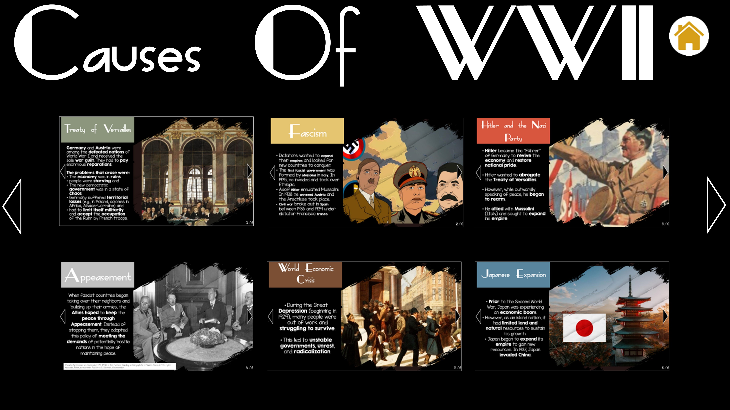
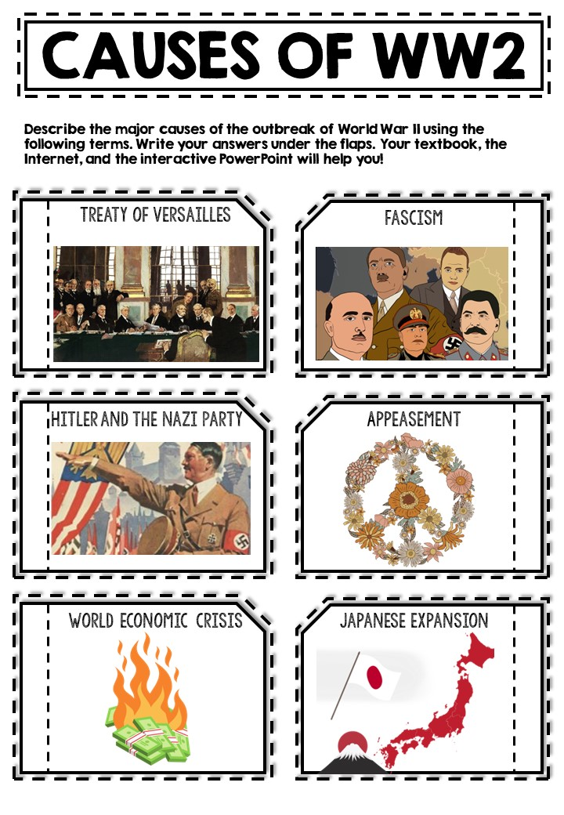
WEEK 4: WORLD WAR II CURRICULUM
RESOURCES | TOPIC AND RESOURCE PREVIEWS | ACTIVITY | ASSESSMENT | ADDITIONAL NOTES
 | Causes of World War II | Introduction | Class discussion | Prompt students to think about the causes of the war. You could brainstorm and add the results on the board
 |  | Interactive PowerPoint: Students use the interactive PowerPoint to explore the causes and factors leading to World War II | Students click through the interactive PowerPoint to find out more. | Students engage with the interactive PowerPoint to understand the underlying causes of the war
 |  | Interactive Notebook: Students use the information from the interactive PowerPoint to complete the corresponding section in their notebook | Teacher assessment of completed notebook section | Students transfer the gathered information from the interactive PowerPoint to their notebooks, reinforcing their knowledge
 |  | Other Ideas: Debate: Was World War II inevitable? | Class debate | Divide students into groups and assign them different perspectives to debate whether World War II was inevitable or could have been prevented

Slide 9
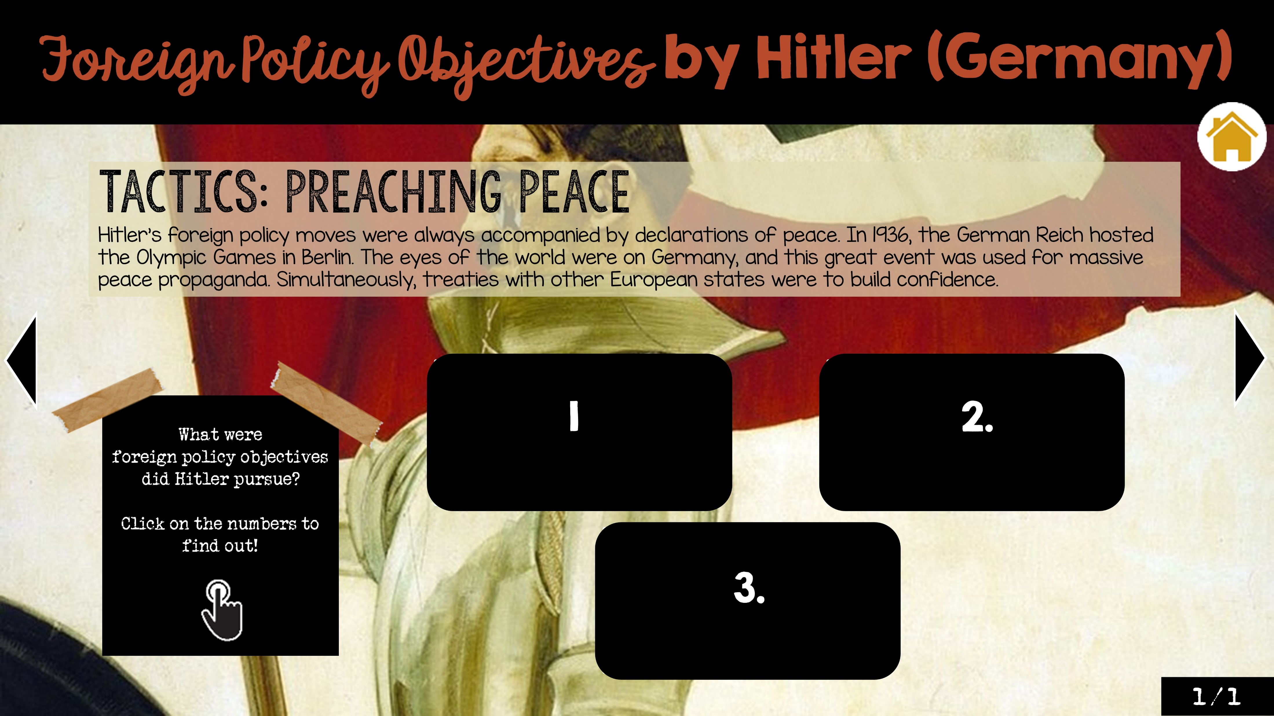
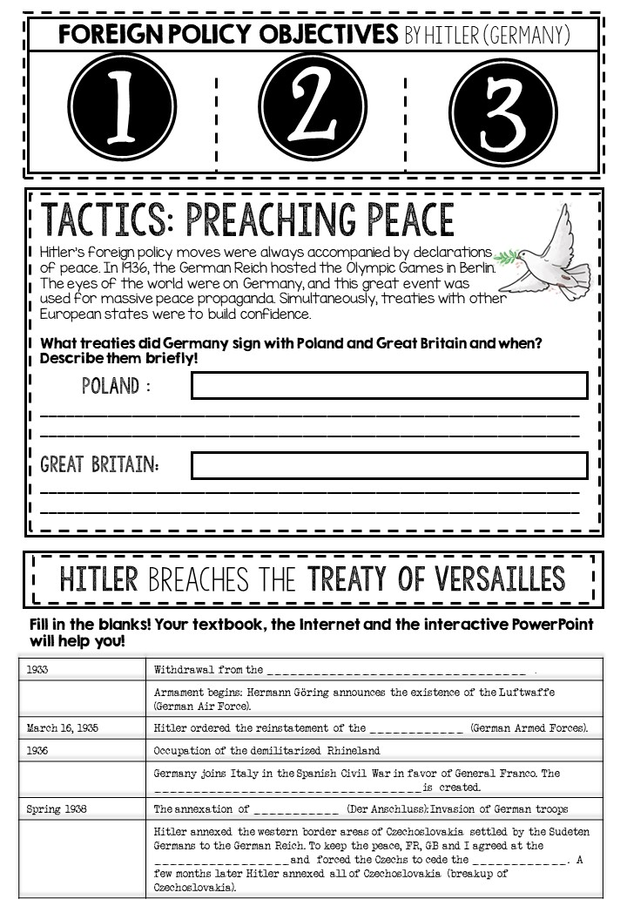
WEEK 5: WORLD WAR II CURRICULUM
RESOURCES | TOPIC AND RESOURCE PREVIEWS | ACTIVITY | ASSESSMENT | ADDITIONAL NOTES
 | German Foreign Policy Goals & War Tactics | Review Activity / Bell Ringer: Provide students with a series of statements related to World War II, such as "War is always avoidable" |  | Have students indicate whether they agree or disagree with each statement and briefly explain their reasoning. This activity will activate their prior knowledge, generate discussion, and set the stage for exploring different perspectives.
 |  | Interactive PowerPoint: Students use the interactive PowerPoint to explore German foreign policy goals and war tactics | Completion of the interactive PowerPoint | Students engage with the interactive PowerPoint
 |  | Interactive Notebook: Students use the information from the interactive PowerPoint to complete the corresponding section in their notebook | Teacher assessment of completed notebook section | Students transfer the gathered information from the interactive PowerPoint to their notebooks, reinforcing their knowledge

Slide 10
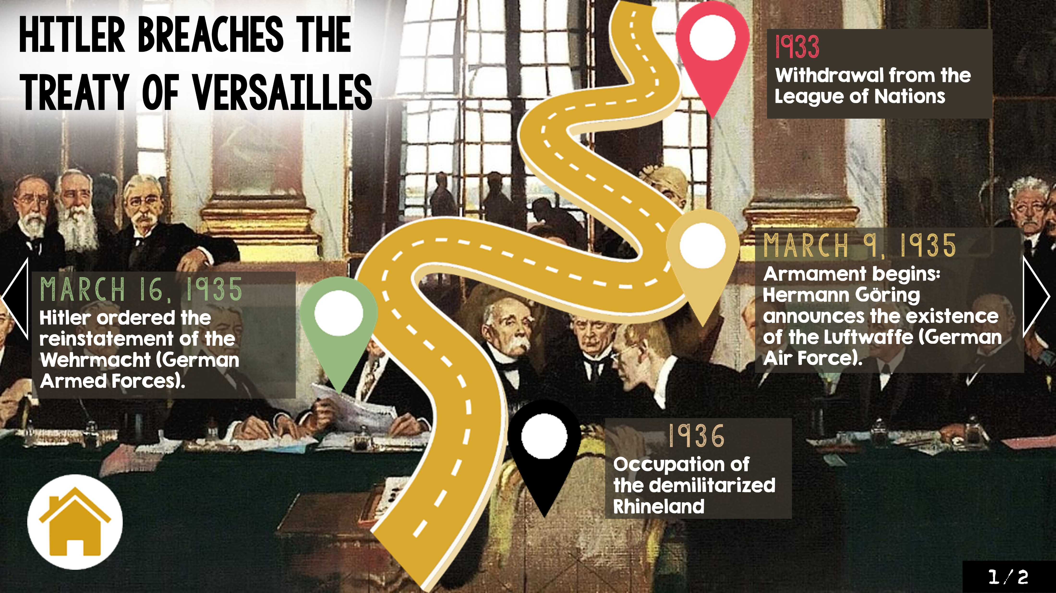
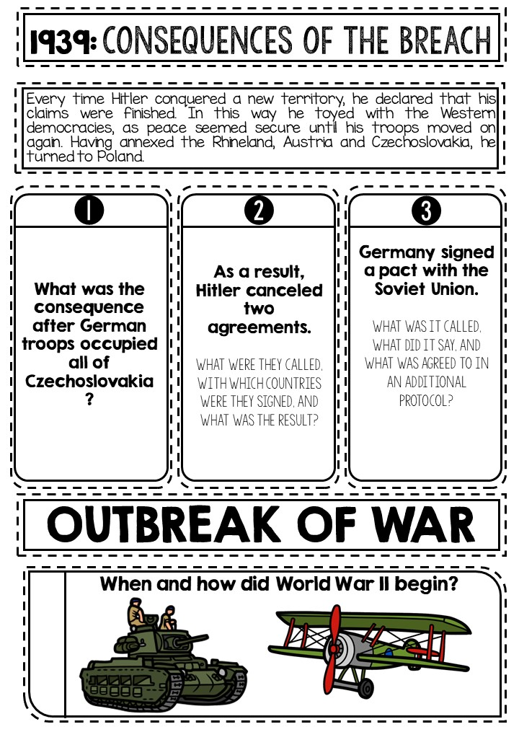
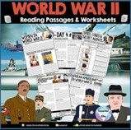
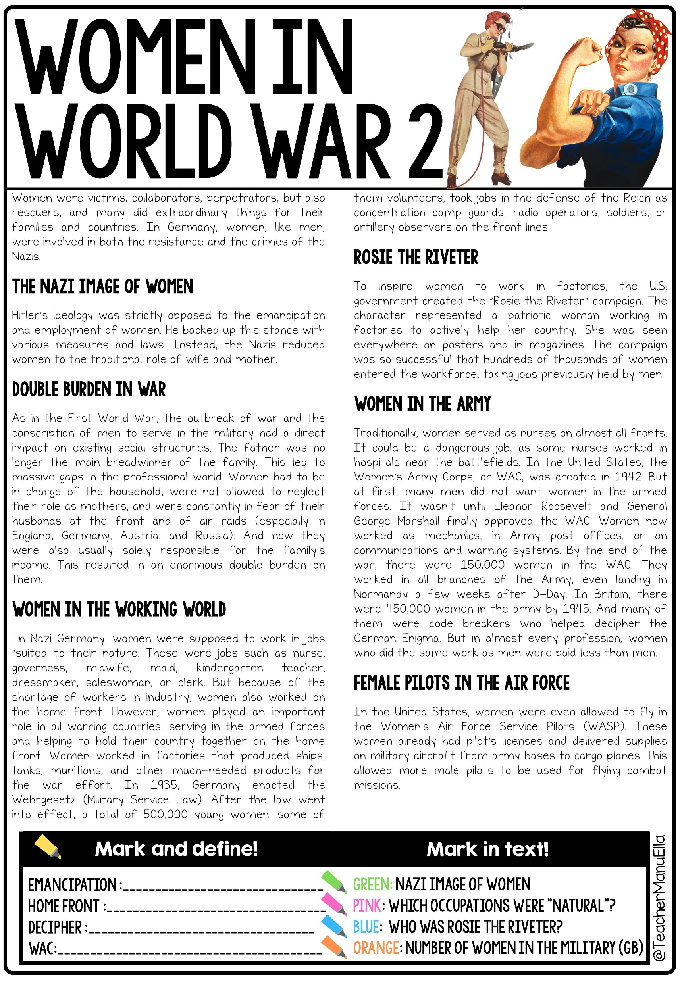
WEEK 6: WORLD WAR II CURRICULUM
RESOURCES | TOPIC AND RESOURCE PREVIEWS | ACTIVITY | ASSESSMENT | ADDITIONAL NOTES
 | Breach of the Treaty of Versailles Consequences & Outbreak of War | Review Activity / Bell Ringer: Present students with a series of statements related to World War II, some of which are true and some of which are false. |  | Students determine whether each statement is fact or fiction and provide a brief explanation. This activity will engage students in critical thinking and challenge their preconceived notions.
 |  | Interactive PowerPoint: Students use the interactive PowerPoint to explore the consequences of breaching the Treaty of Versailles | Students click through the interactive PowerPoint to find out more. | Students engage with the interactive PowerPoint to understand the underlying causes of the war
 |  | Interactive Notebook: Students use the information from the interactive PowerPoint to complete the corresponding section in their notebook | Teacher assessment of completed notebook section | Students transfer the gathered information from the interactive PowerPoint to their notebooks, reinforcing their knowledge
 |  | Reading Passage: Women in the 2nd World War | Comprehension questions on the worksheets included and/or class discussion | This text focuses specifically focusing on the contributions and experiences of women during World War II

Slide 11
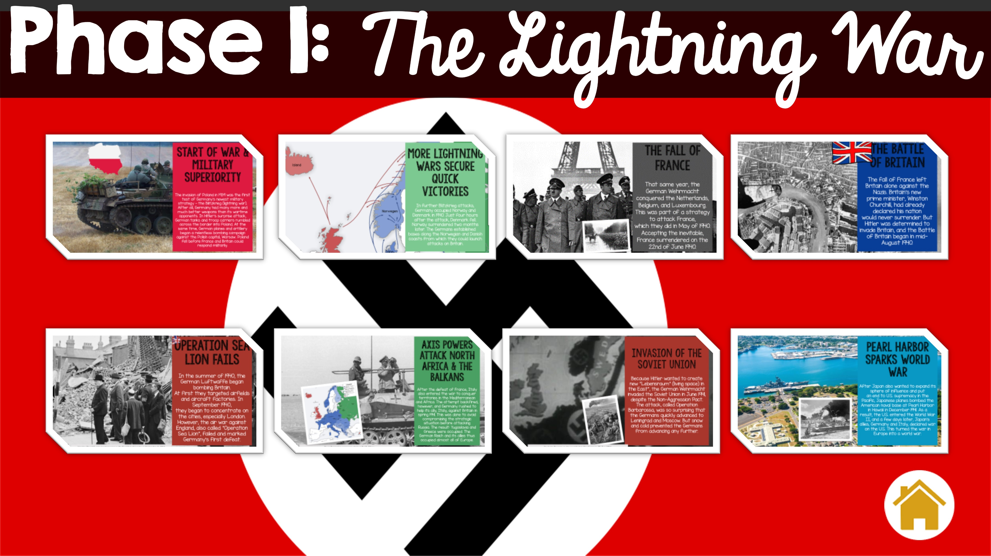
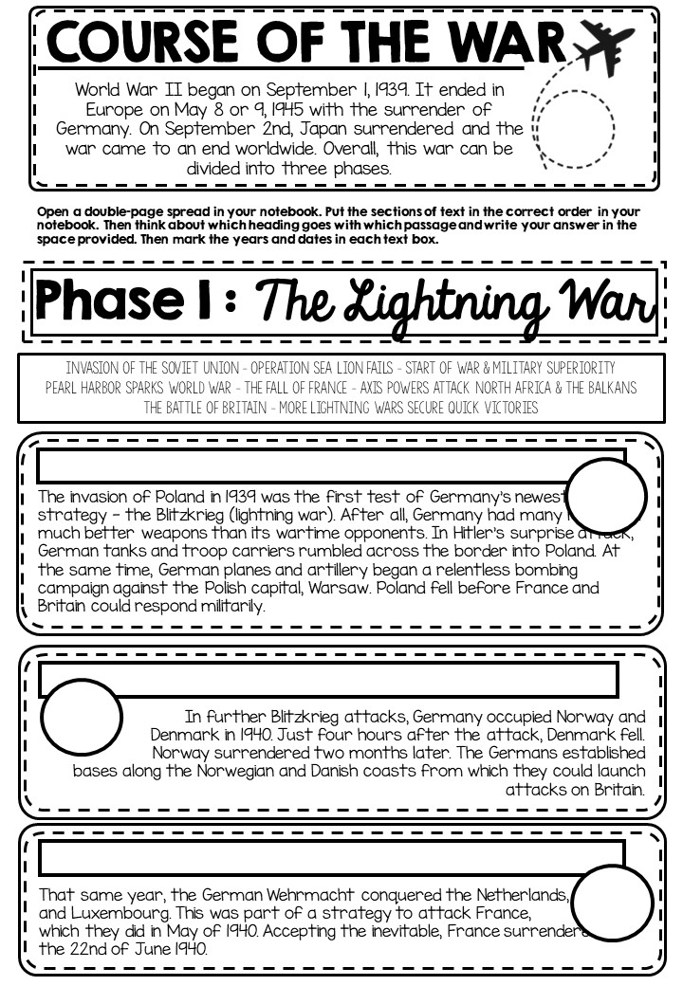
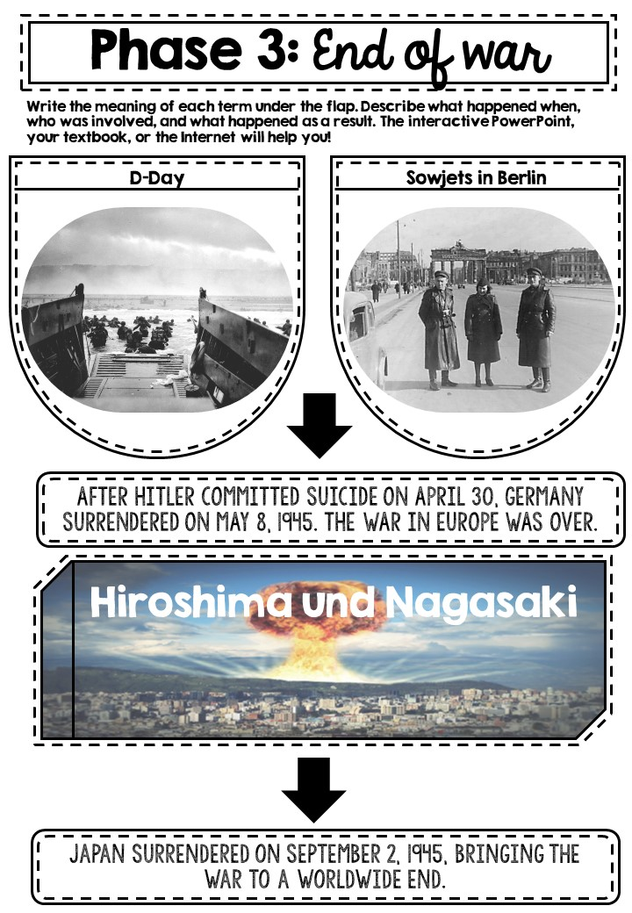
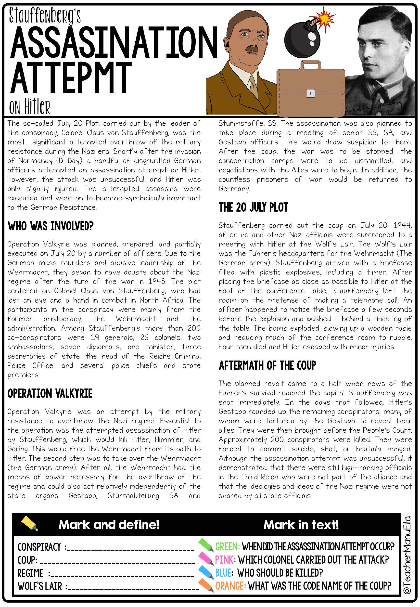
WEEK 7: WORLD WAR II CURRICULUM
RESOURCES | TOPIC AND RESOURCE PREVIEWS | ACTIVITY | ASSESSMENT | ADDITIONAL NOTES
 | Course of the War: 3 Phases - Blitzkrieg, The Turning Point, The End of the War | I
 |  | Interactive PowerPoint: Students use the interactive PowerPoint to explore the three phases of the war | Students click through the interactive PowerPoint to find out more. | Students engage with the interactive PowerPoint to understand the underlying causes of the war
 |  | Interactive Notebook: Students use the information from the interactive PowerPoint to complete the corresponding section in their notebook | Teacher assessment of completed notebook section | Students transfer the gathered information from the interactive PowerPoint to their notebooks, reinforcing their knowledge
 |  | Reading Passage: Operation Valkyrie Assassination Attempt on Hitler | Comprehension questions on the worksheets included and/or class discussion | This text focuses specifically on the famous assassination attempt on Hitler. Tip: You could watch the movie “Valkyrie” with Tom Cruise.

Slide 12
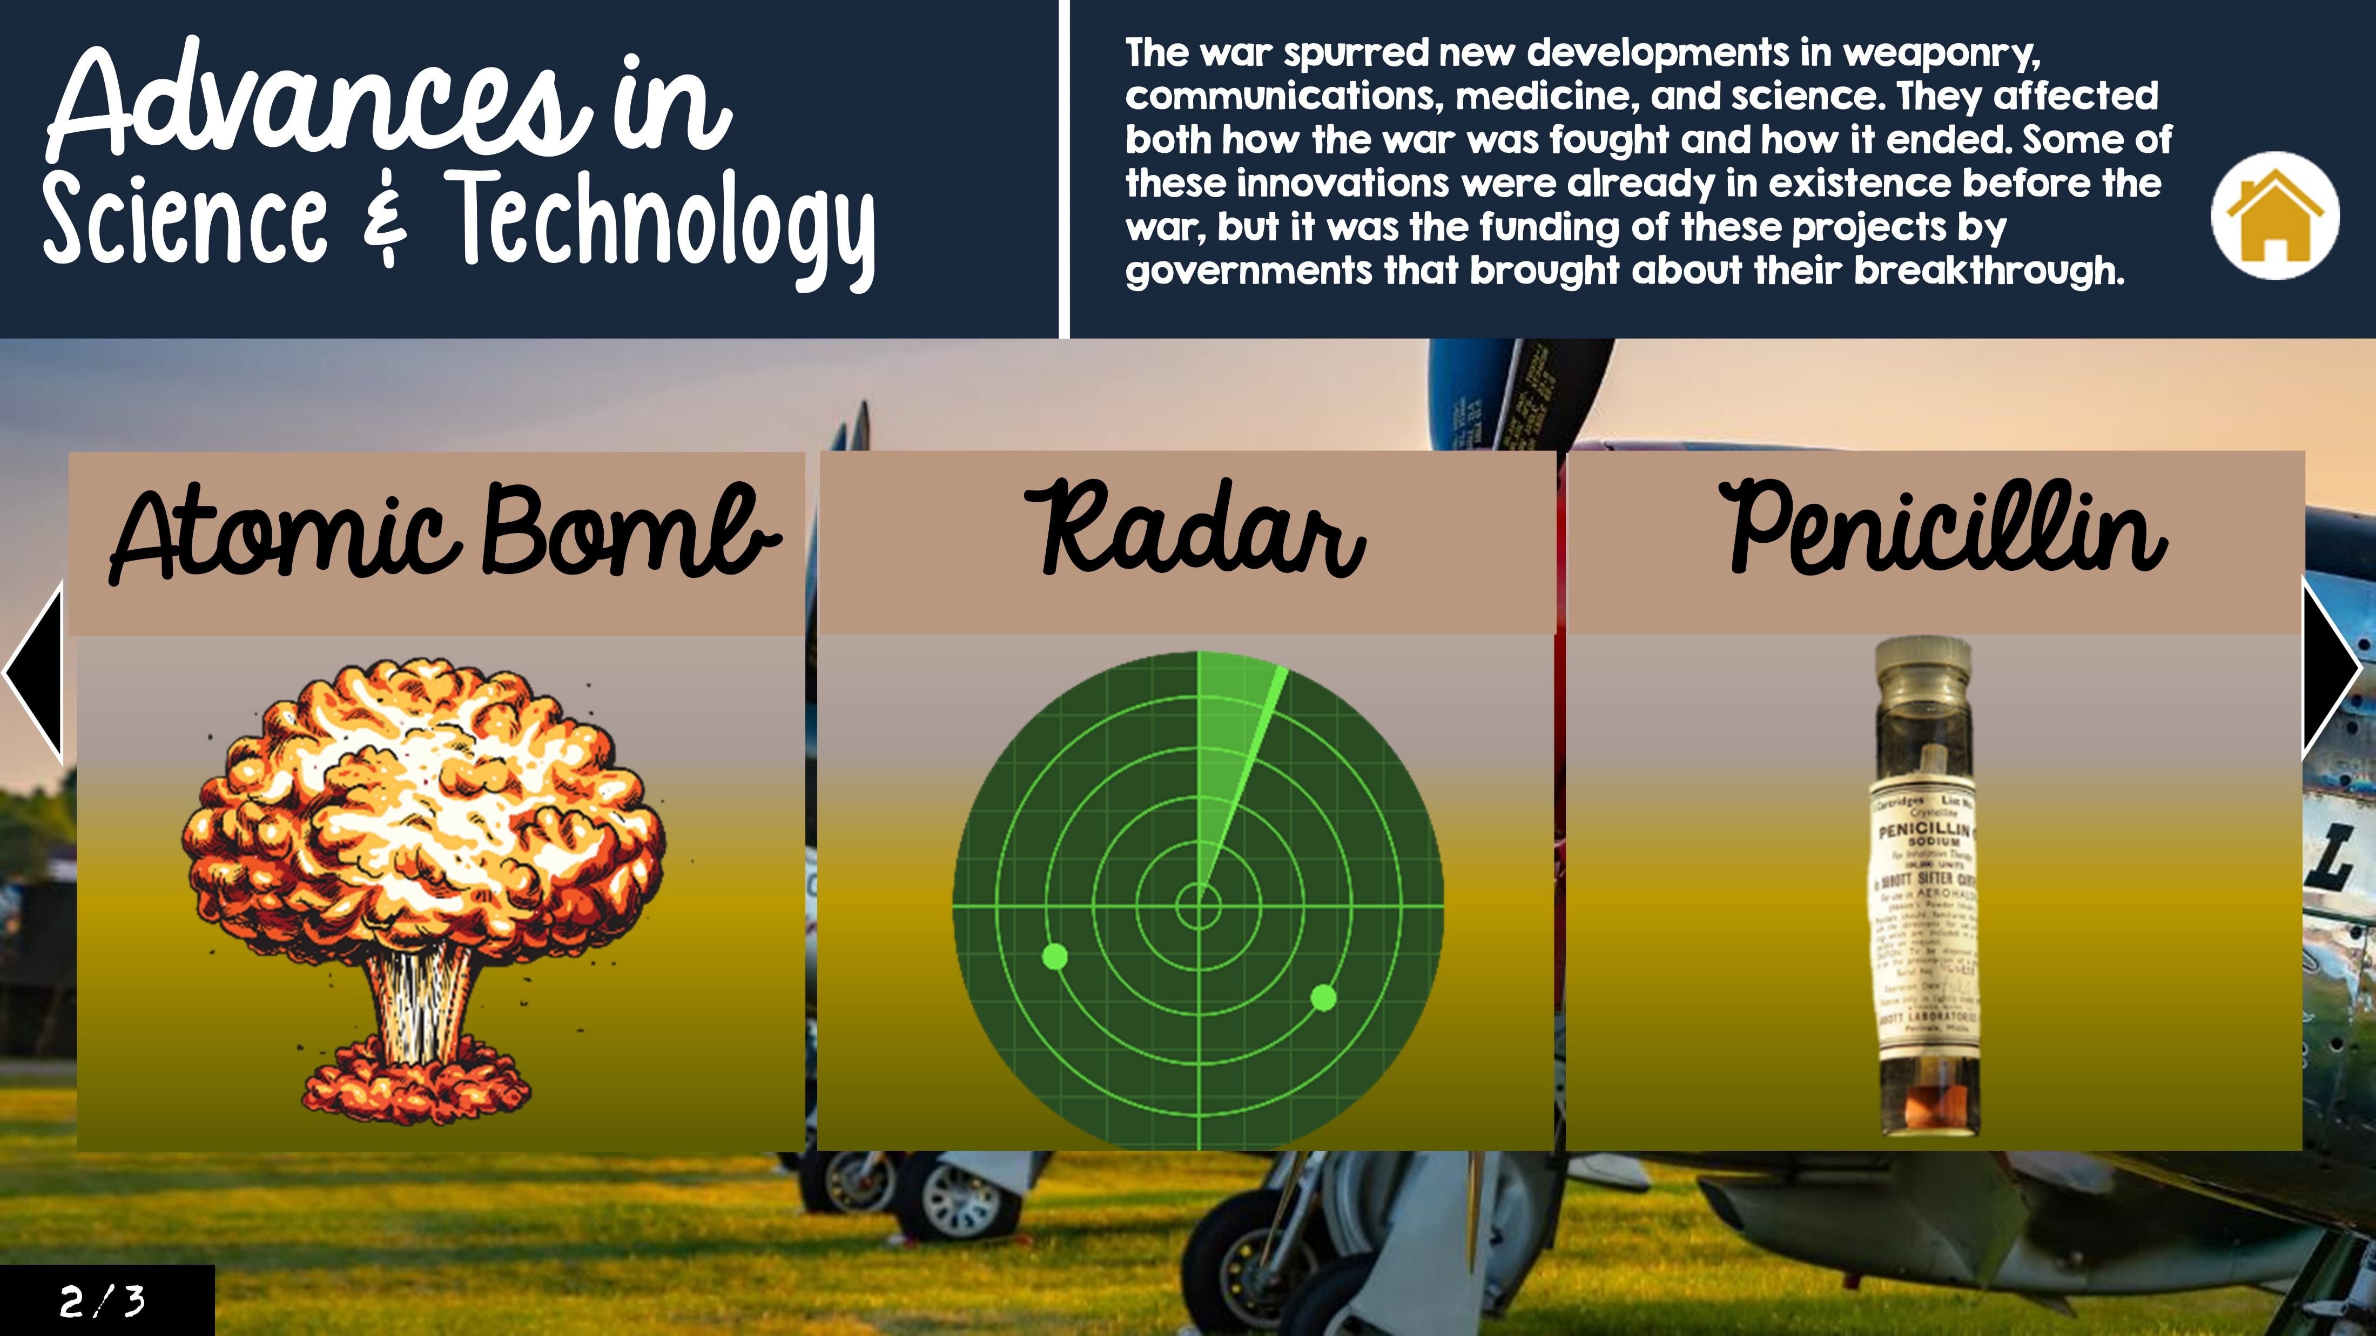
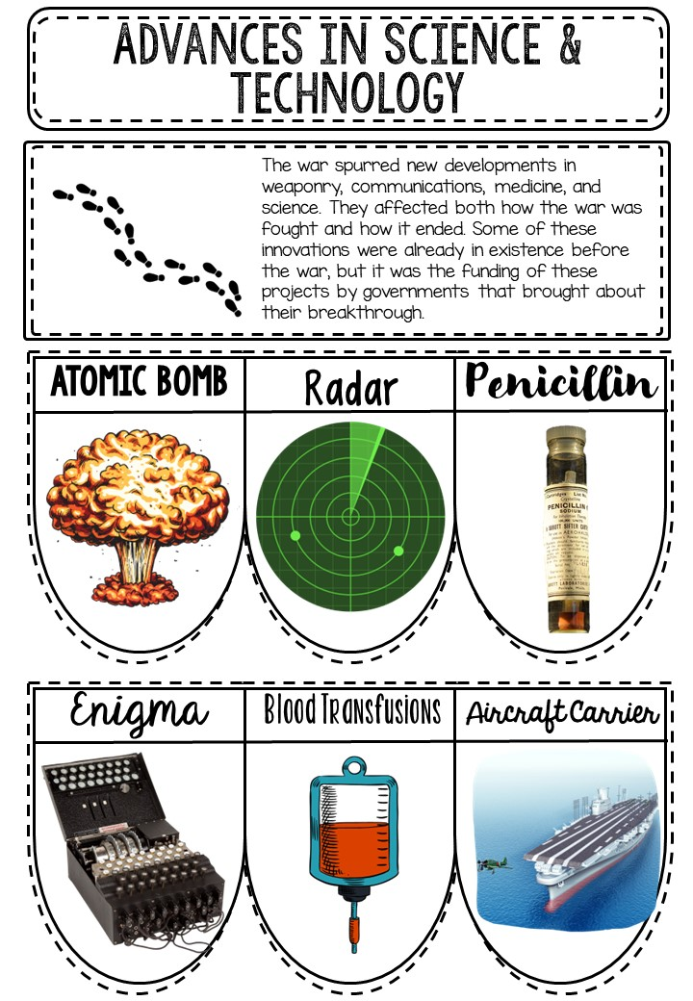
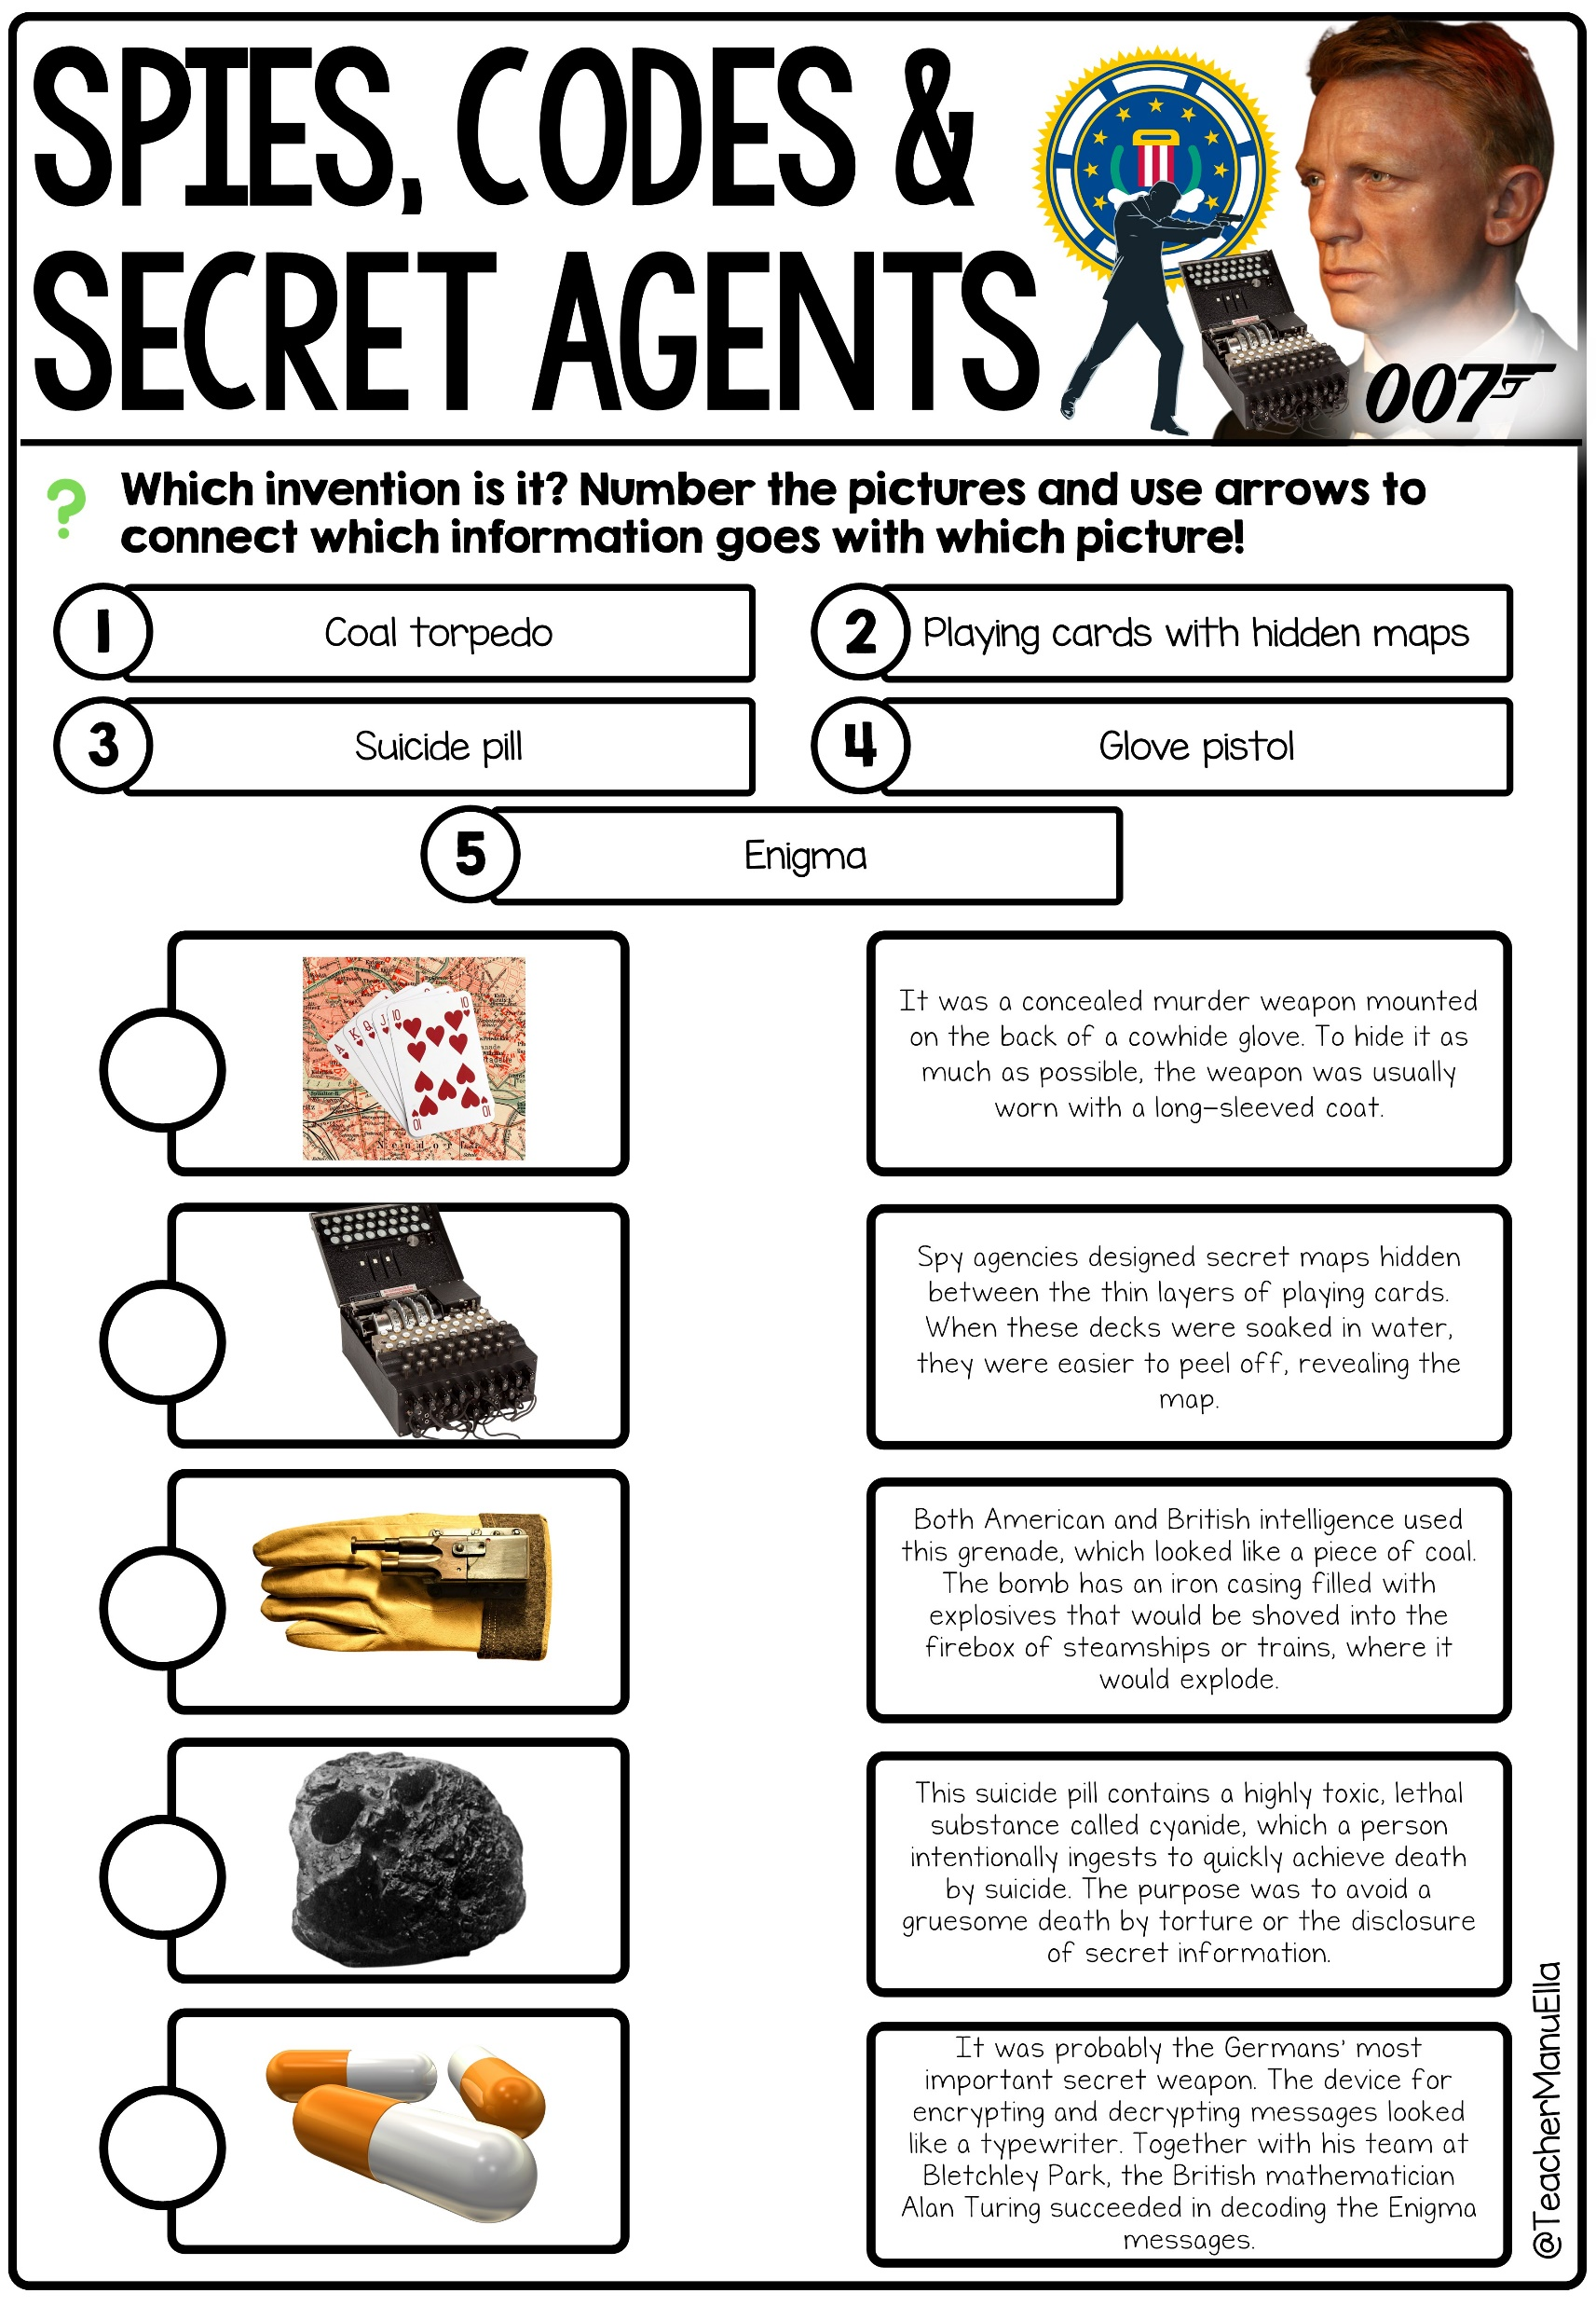
WEEK 9: WORLD WAR II CURRICULUM
RESOURCES | TOPIC AND RESOURCE PREVIEWS | ACTIVITY | ASSESSMENT | ADDITIONAL NOTES
 | Advances in Science & Technology (Enigma, Radar, Atomic Bomb, Penicillin, Blood Transfusions) | Review Activity / Bell Ringer: Share a primary source document related to a significant event during World War II, such as a speech, diary entry, or newspaper article. |  | Ask students to analyze the source and answer questions about its content, context, and possible biases. This activity will develop students' historical analysis skills and promote discussion.
 |  | Interactive PowerPoint: Students use the interactive PowerPoint to explore the advancements in science and technology during World War II | Students click through the interactive PowerPoint to find out more. | Students actively engage with the interactive PowerPoint to learn about the significant events during World War II
 |  | Interactive Notebook: Students use the information from the interactive PowerPoint to complete the corresponding section in their notebook | Teacher assessment of completed notebook section | Students transfer the gathered information from the interactive PowerPoint to their notebooks, reinforcing their knowledge of the timeline
 |  | Reading Passage: Spies, Codes and Secret Agents (Codebreakers & Enigma) | Comprehension questions on the worksheets included and/or class discussion | This text focuses specifically on codebreaking efforts, including the Enigma machine, during World War II
 |  | Other Ideas: Research and present on a specific scientific or technological advancement of World War II | Presentation or written report | Assign each student a specific scientific or technological advancement from the war and have them research and present their findings to the class

Slide 13

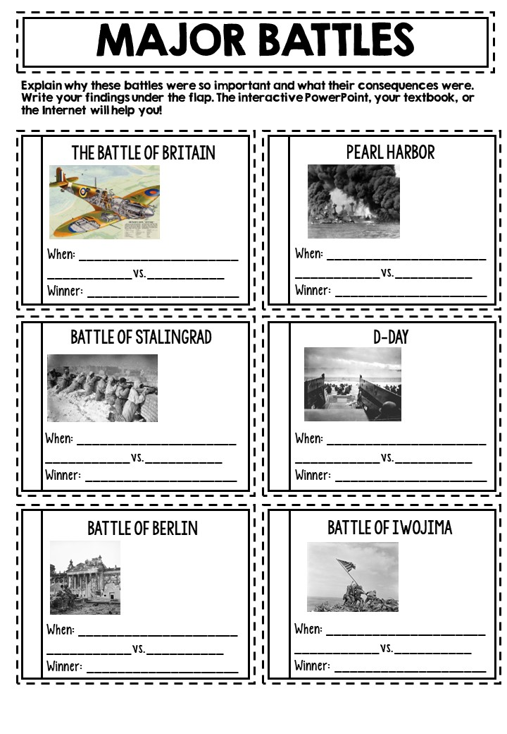
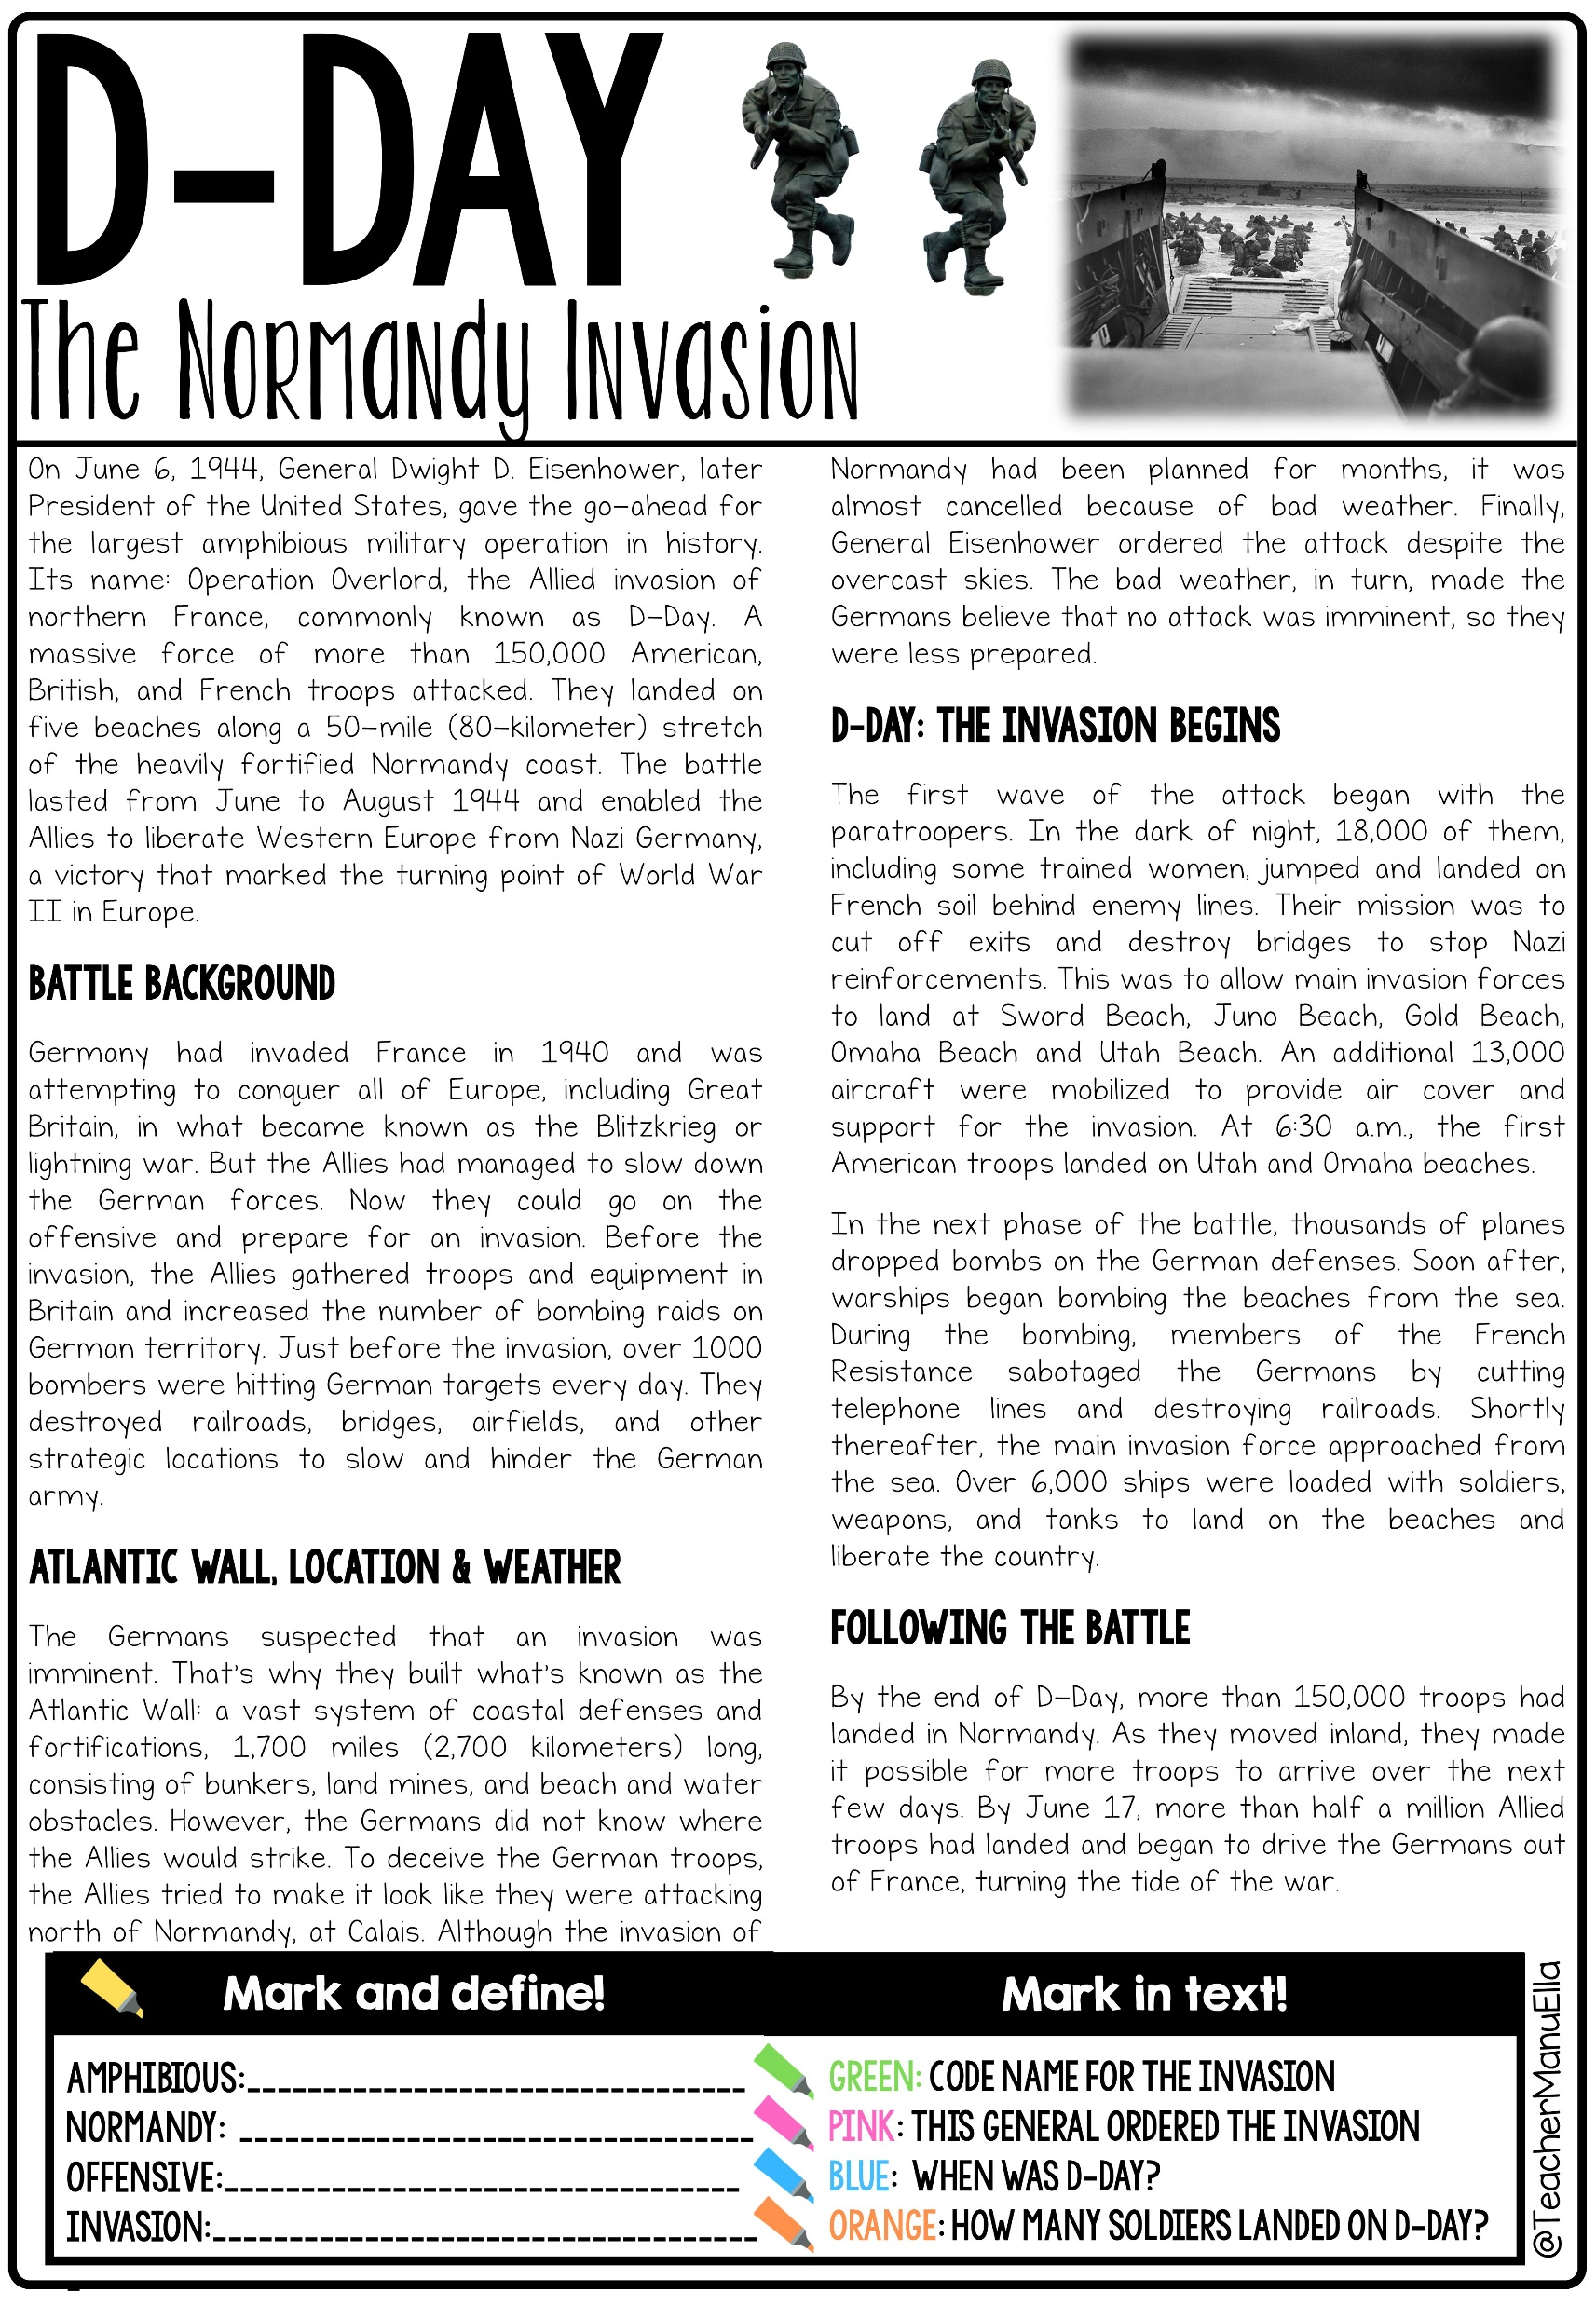
WEEK I0: WORLD WAR II CURRICULUM
RESOURCES | TOPIC AND RESOURCE PREVIEWS | ACTIVITY | ASSESSMENT | ADDITIONAL NOTES
 | Major Battles | Review Activity / Bell Ringer: "Timeline Scramble“ Provide students with a scrambled timeline of significant events from World War II. |  | Their task is to rearrange the events in chronological order as quickly as possible. This activity will help students develop a chronological understanding of the war's key events.
 |  | Interactive PowerPoint: Students use the interactive PowerPoint to explore major battles of World War II | Students click through the interactive PowerPoint to find out more. | Students actively engage with the interactive PowerPoint to learn about the significant events during World War II
 |  | Interactive Notebook: Students use the information from the interactive PowerPoint to complete the corresponding section in their notebook | Teacher assessment of completed notebook section | Students transfer the gathered information from the interactive PowerPoint to their notebooks, reinforcing their knowledge of the timeline
 |  | Reading Passage: D-Day | Comprehension questions on the worksheets included and/or class discussion | This text focuses specifically on on the Normandy Invasion (D-Day) and its significance in World War II
 | Review, Final Assessment | Final Assessment | Final Assessment | If you're short on time for creating assessments, don't worry—I've got you covered!

Slide 14




GET MORE!
Don't miss out on my other FREEBIES, the latest teaching resources, sales, and special offers - follow me on TpT and click this link to stay updated!
LEAVE A REVIEW &
SAVE MONEY
Did you know: You can earn credits toward future purchases by leaving reviews on the products you buy. Well, you can! It only takes a few minutes, earns you points toward free resources, and helps the seller get recognition, too!

