Slide 1
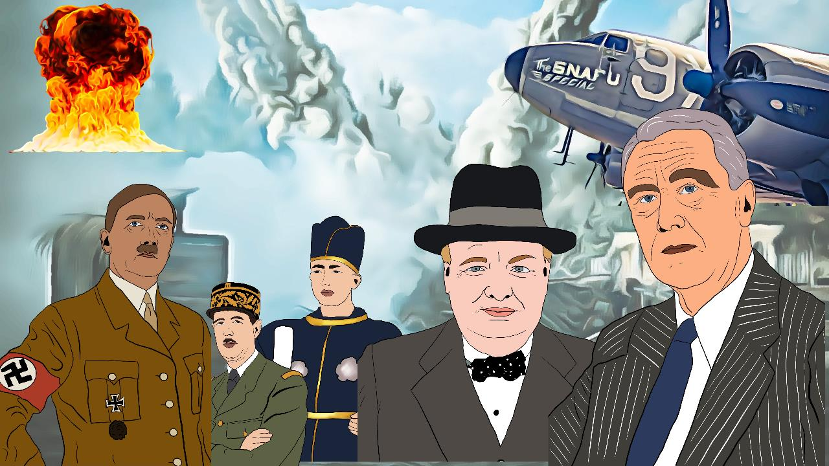

WORLD WAR II
Click on the "Slideshow" icon at the bottom right of the first slide.
Only then will the music start automatically.

Slide 2



your Journey into the
Past
starts IN …
1
2
3

Slide 3
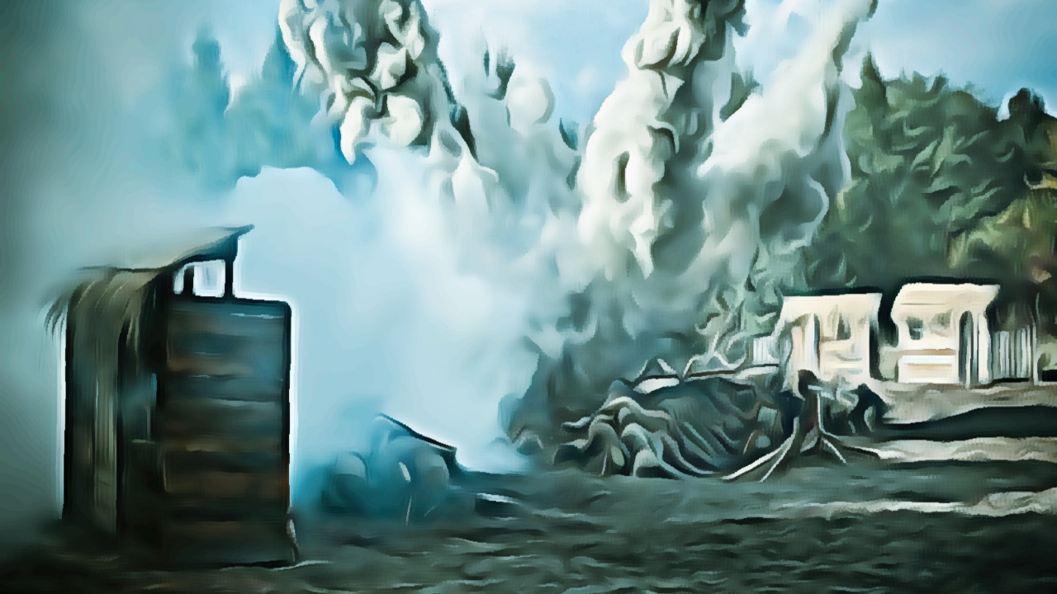

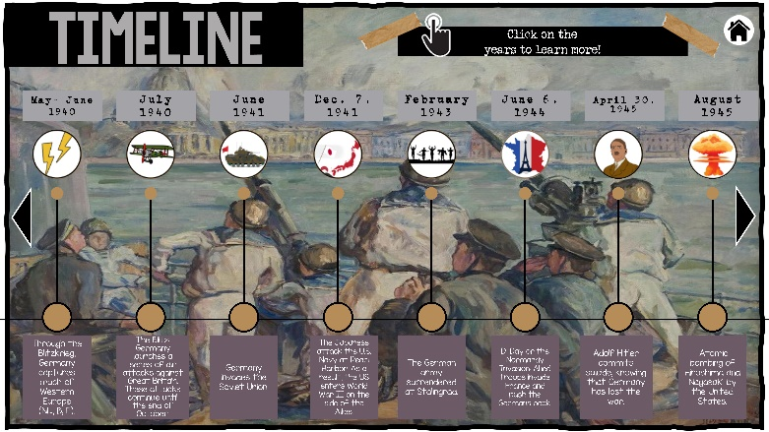
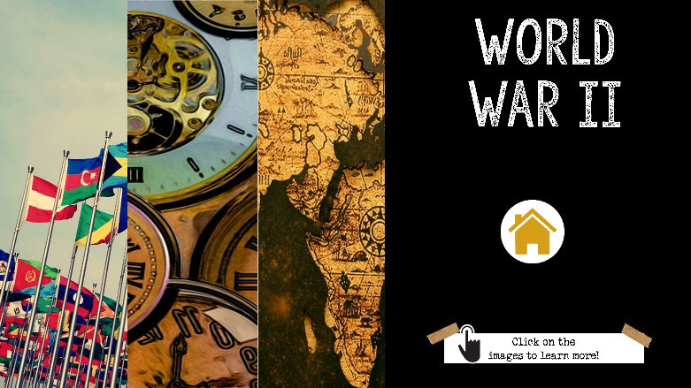
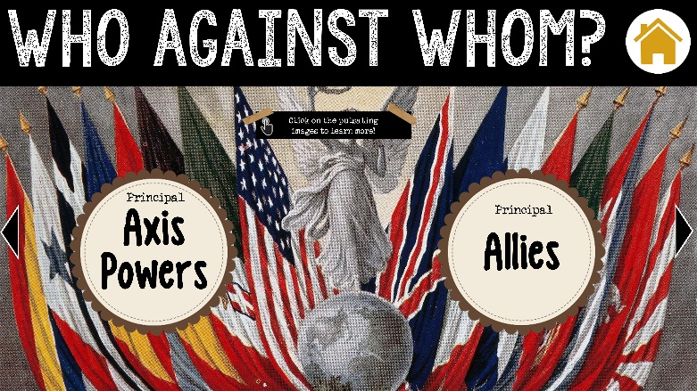
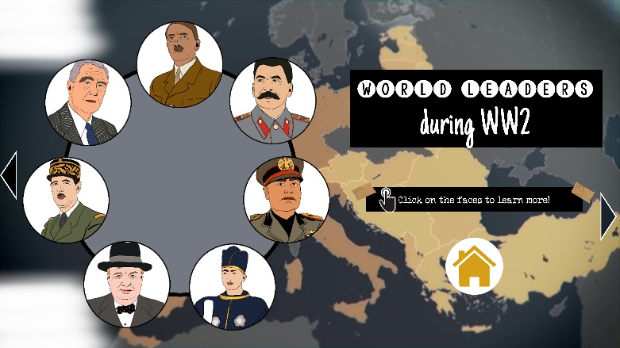
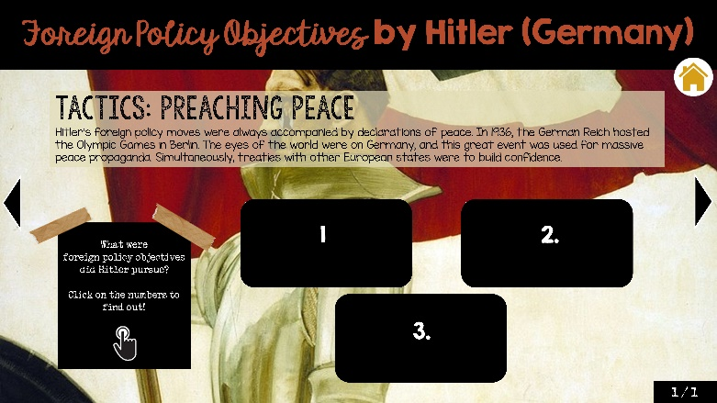
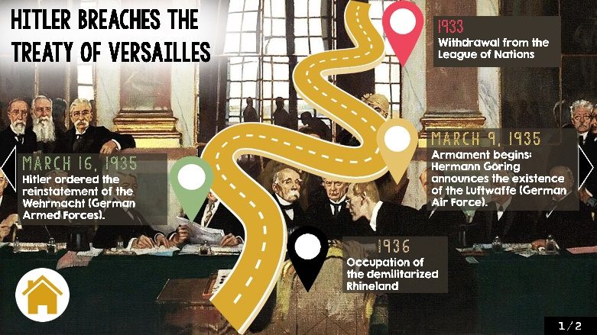
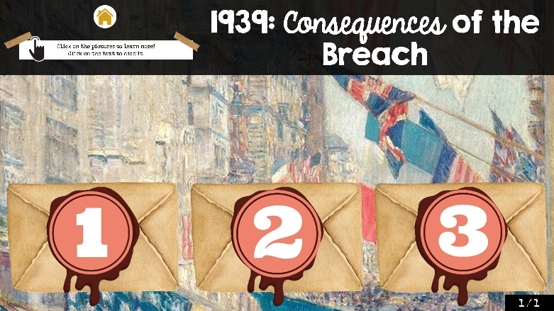
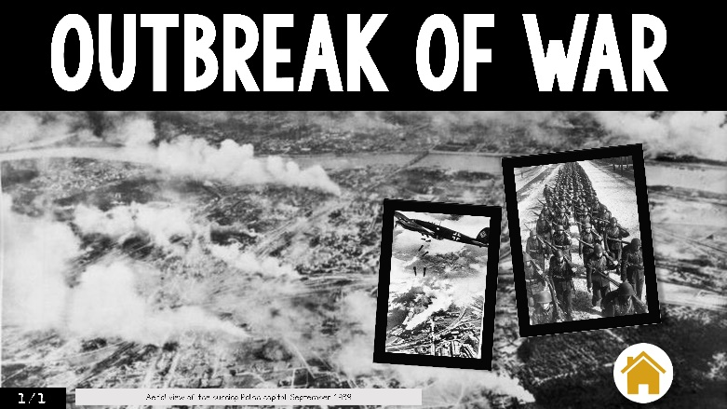
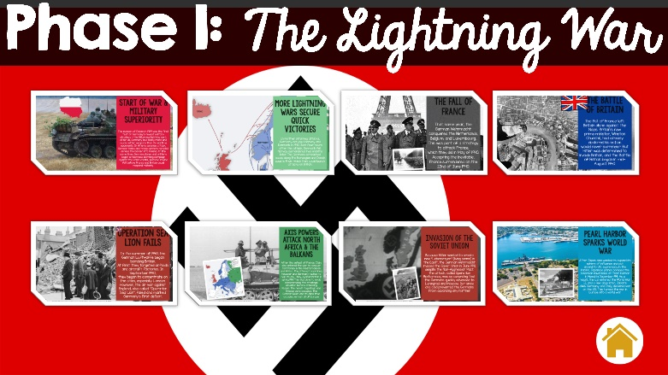
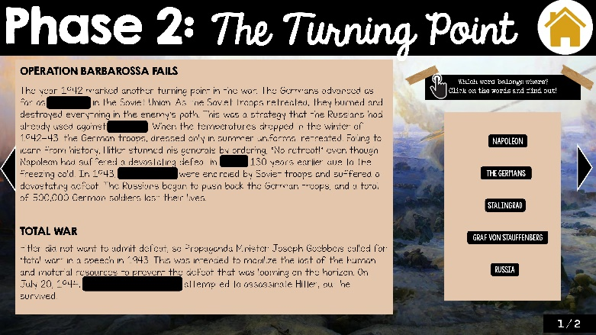
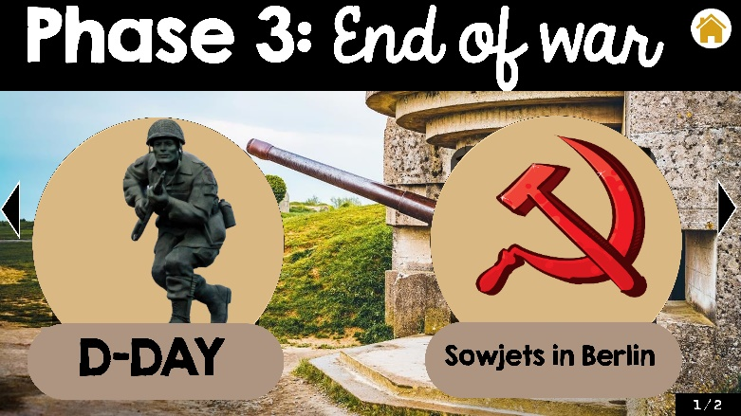
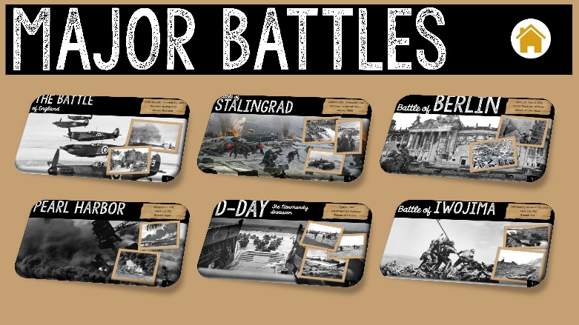
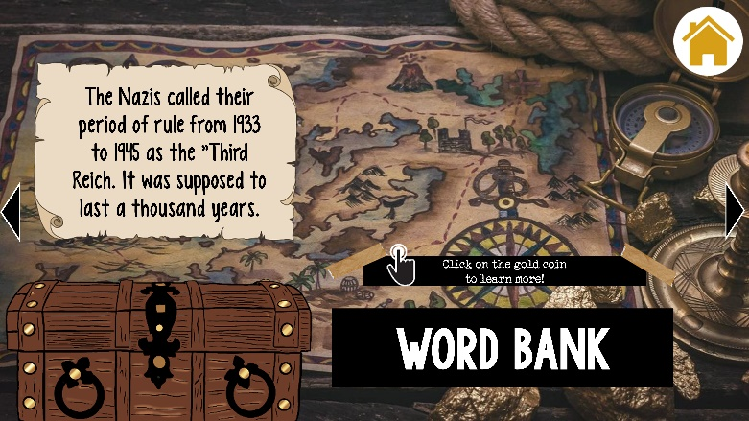
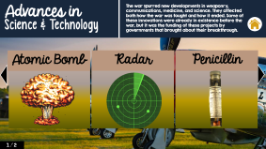
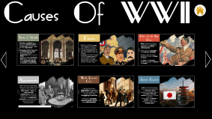
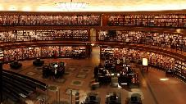
OVERVI
EW
TIMELINE
OVERVIEW
WHO AGAINST WHOM
WORLD LEADERS
CAUSES OF WW2
OBJECTIVES & TACTICS
breach of contract
CONSEQUENCES of breach
OUTBREAK OF WAR
PHASE 1
PHASE 2
PHASE 3
TECHNOLOGY & SCIENCE
MAJOR BATTLES
WORD BANK
SOURCES

Slide 4


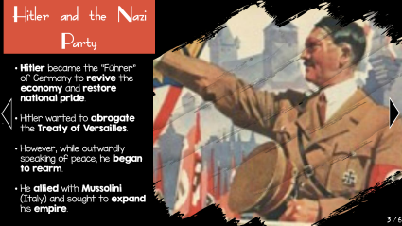

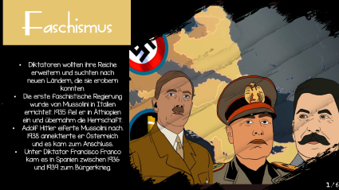
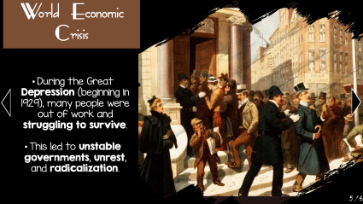
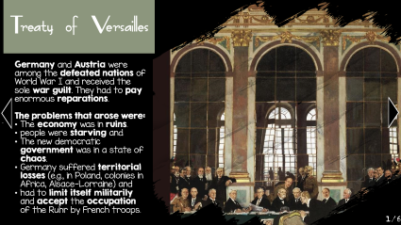
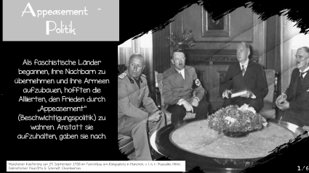

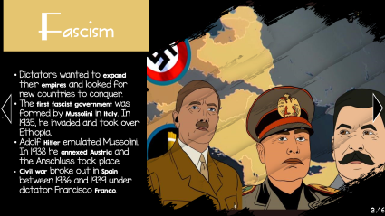
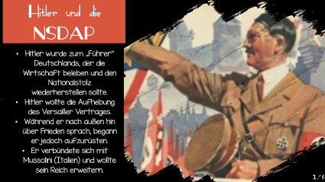
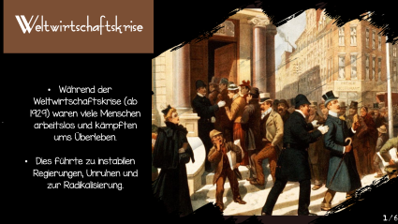
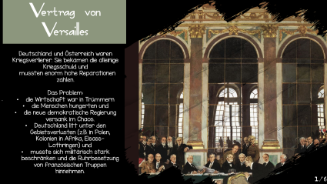
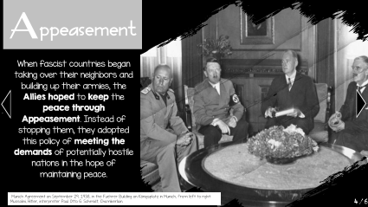
Causes Of WWII

Slide 5
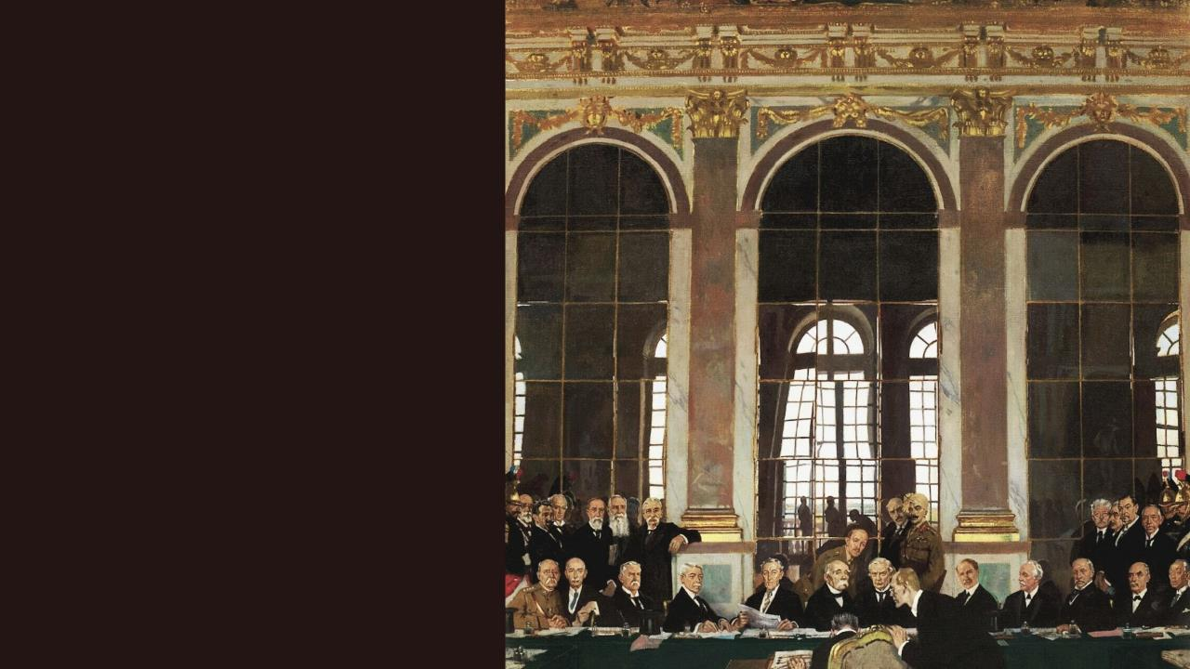
.
Treaty of Versailles
Germany and Austria were among the defeated nations of World War I and received the sole war guilt. They had to pay enormous reparations.
The problems that arose were:
The economy was in ruins.
people were starving and
The new democratic government was in a state of chaos.
Germany suffered territorial losses (e.g., in Poland, colonies in Africa, Alsace-Lorraine) and
had to limit itself militarily and accept the occupation of the Ruhr by French troops.
1/6

Slide 6
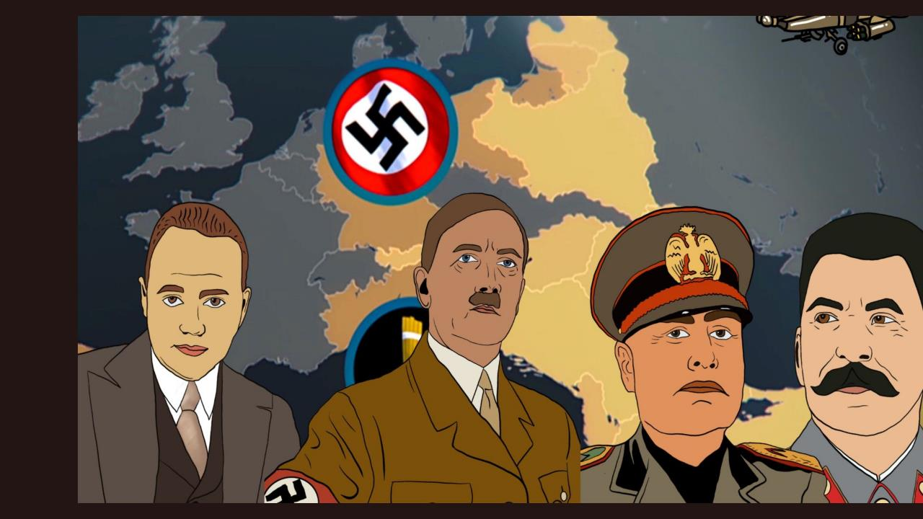
.
Fascism
Dictators wanted to expand their empires and looked for new countries to conquer.
The first fascist government was formed by Mussolini in Italy. In 1935, he invaded and took over Ethiopia.
Adolf Hitler emulated Mussolini. In 1938 he annexed Austria and the Anschluss took place.
Civil war broke out in Spain between 1936 and 1939 under dictator Francisco Franco.
2/6

Slide 7
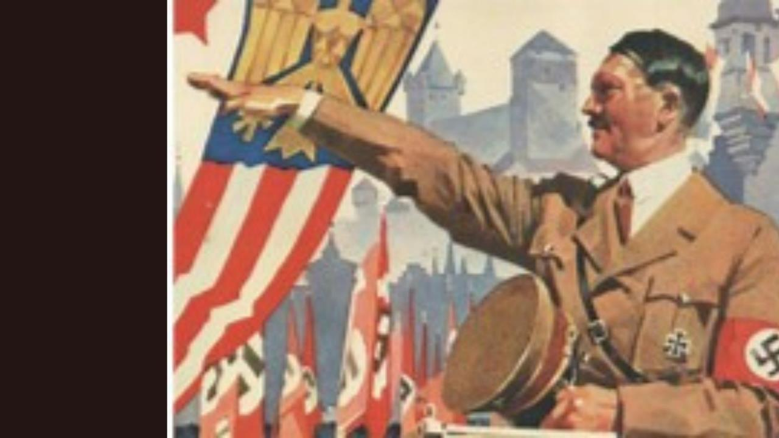
.
Hitler and the Nazi Party
Hitler became the “Führer" of Germany to revive the economy and restore national pride.
Hitler wanted to abrogate the Treaty of Versailles.
However, while outwardly speaking of peace, he began to rearm.
He allied with Mussolini (Italy) and sought to expand his empire.
3/6

Slide 8
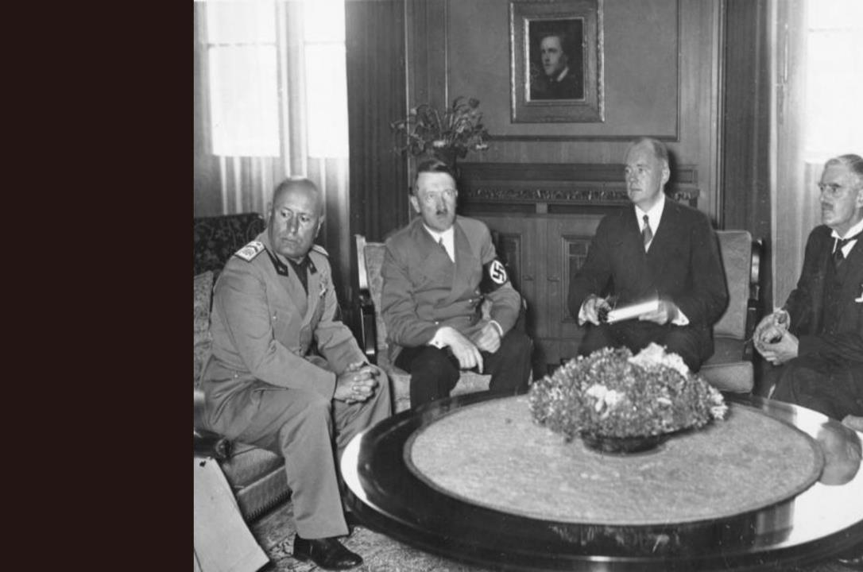
.
Appeasement
When fascist countries began taking over their neighbors and building up their armies, the Allies hoped to keep the peace through Appeasement. Instead of stopping them, they adopted this policy of meeting the demands of potentially hostile nations in the hope of maintaining peace.
Munich Agreement on September 29, 1938, in the Fuehrer Building on Königsplatz in Munich, from left to right: Mussolini, Hitler, interpreter Paul Otto G. Schmidt, Chamberlain
4/6

Slide 9
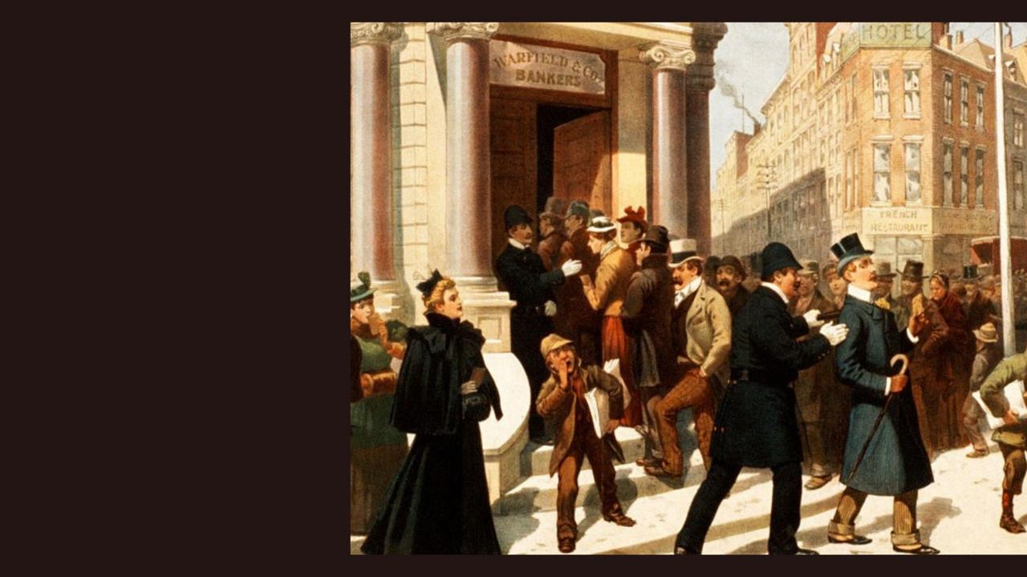
.
World Economic Crisis
During the Great Depression (beginning in 1929), many people were out of work and struggling to survive.
This led to unstable governments, unrest, and radicalization.
5/6

Slide 10

.
Japanese Expansion
Prior to the Second World War, Japan was experiencing an economic boom.
However, as an island nation, it had limited land and natural resources to sustain its growth.
Japan began to expand its empire to gain new resources. In 1937, Japan invaded China.
6/6

Slide 11
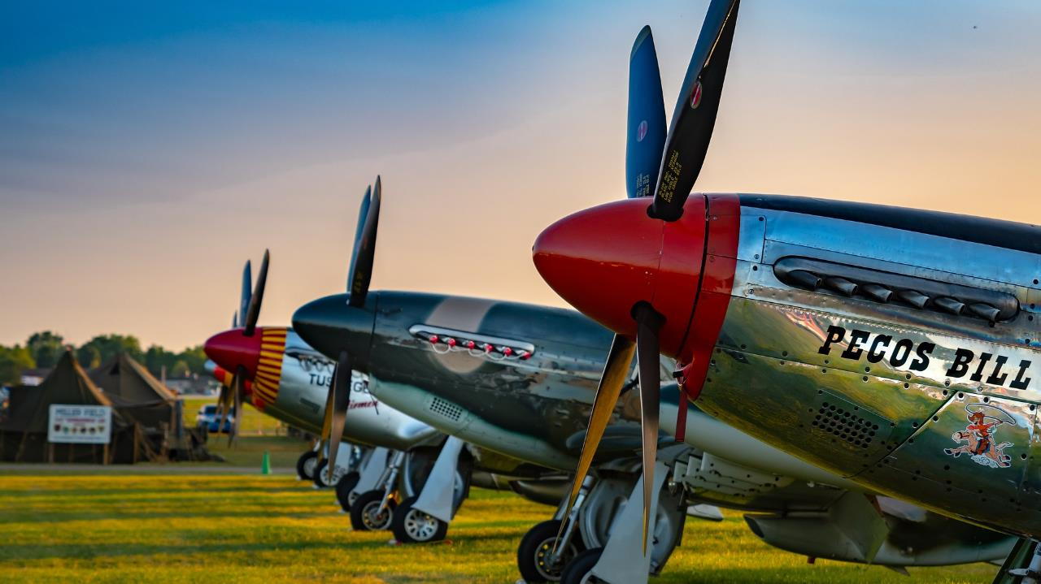


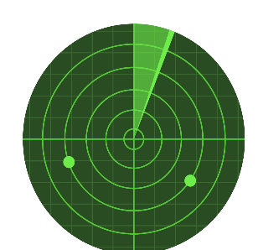
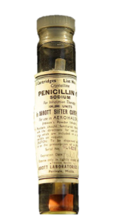
Advances in
Science & Technology
The war spurred new developments in weaponry, communications, medicine, and science. They affected both how the war was fought and how it ended. Some of these innovations were already in existence before the war, but it was the funding of these projects by governments that brought about their breakthrough.
Atomic Bomb
Radar
Penicillin
This bomb used nuclear reactions to create a huge explosion.
Albert Einstein developed many of the theories that helped in its development.
The research program to develop the atomic bomb was called the Manhattan Project.
The United States first used the atomic bomb to bomb the Japanese cities of Hiroshima and Nagasaki, Japan.
Radar helped the Allies detect enemy ships and planes.
The British were the first to use radar. It helped them fight off the Germans in the Battle of Britain.
Some historians have argued that radar was the single most important technology and did more to help the Allies win the war than any other technology, including the atomic bomb.
Alexander Fleming discovered penicillin in 1928, but it was not until World War II that the United States began mass production.
In preparation for the Normandy landings (D-Day), 2.3 million doses of penicillin were produced for Allied troops.
After the war, civilians also gained access to this life-saving drug.
1/2

Slide 12
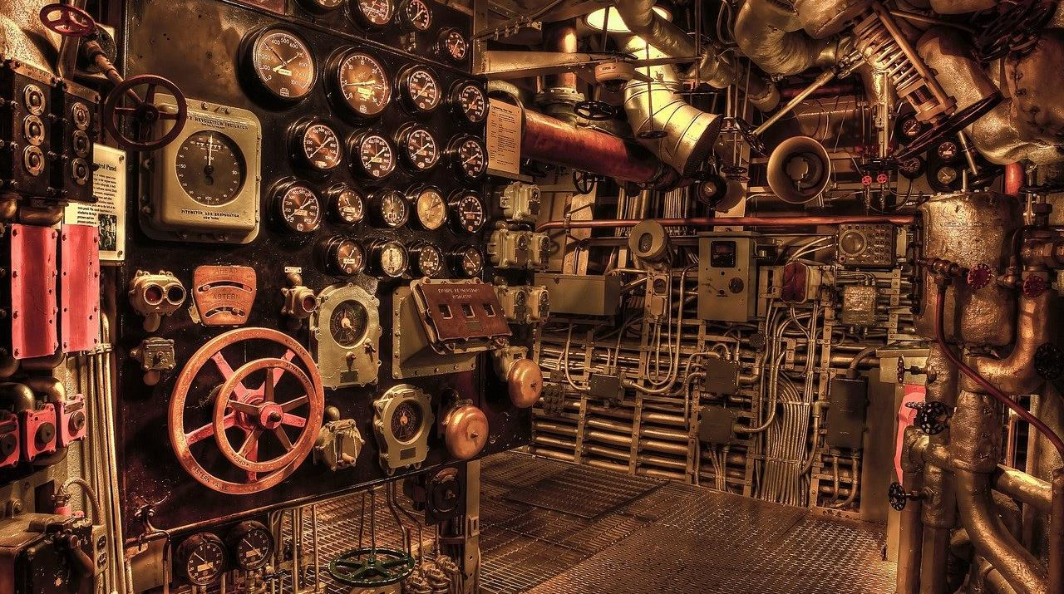
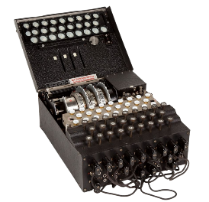

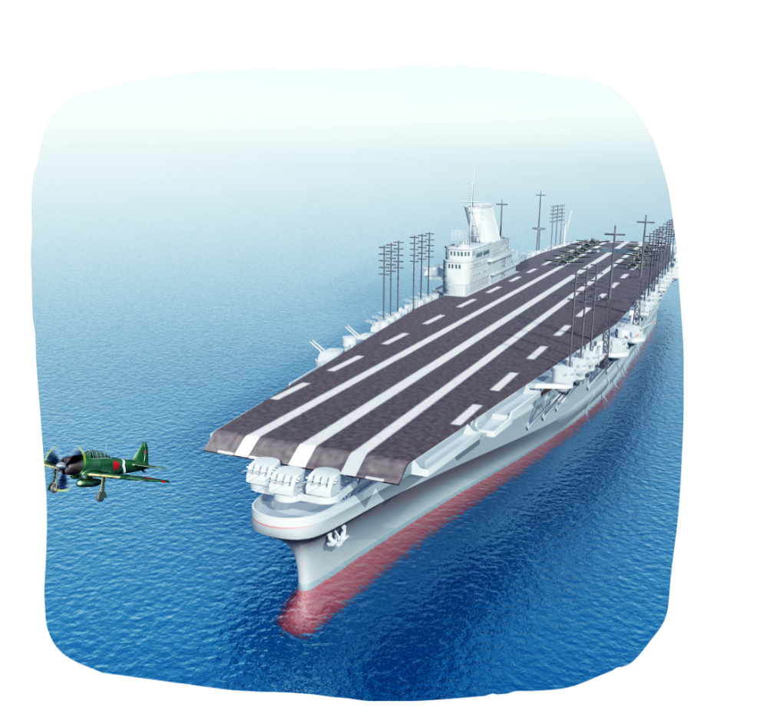

Advances in Science & Technology
Enigma
Blood Transfusions
Aircraft Carrier
To keep communications secret, both sides developed their own secret codes.
The Germans used a machine called Enigma to encrypt and decrypt their messages.
British scientist Alan Turing invented a machine that could break the code.
It was a precursor to the computer and gave the Allies an advantage in battle. in the battle.
The American surgeon Charles Drew standardized the production of blood plasma.
This involved mixing water and freeze-dried blood plasma.
Unlike whole blood, plasma could be administered to anyone, regardless of blood type, making treatment on the battlefield easier.
Carriers became the most important and fearsome vessels of the navy.
They could take off and land aircraft anywhere in the ocean to carry out air raids.
The largest were about 245 meters long and 30 meters wide. They could carry about 100 planes. Thousands of sailors were needed to control and maintain them.
2/2

Slide 13


USER GUIDE
Click the Home button to return to the overview.
If there is an overview slide during the presentation, click anywhere on the slide to go back to that overview slide.
You can also click the arrow to the right to go to the next slide or the arrow to the left to go back one slide.

Slide 14

Music
Fonts
http://www.kimberlygeswein.com/
KG Second Changes Solid
KG Second Changes Sketch
KG Sorry not Sorry
KG Sorry not Sorry Chub
KG Two is Better Than One Regular
KG Primary Penmanship 2
KG What the Teacher Wants
KG Blank Space Solid
KG Blank Space Sketch
KG Red Hands
KG Corner of the Sky
KG Neatly Printed
KG Always a good Time
KG LET HER GO SOLID
KG Chasing Cars
KG Empire of Dirt
KG Defying Gravity
KG Counting Stars
KG Satisfied Script
Veteran Typewriter
Track 1 from slide 1: Top Of The World by tubebackr | https://soundcloud.com/tubebackrMusic promoted by https://www.free-stock-music.com
Track 2 from slide 3: Tragedy by MaxKoMusic | https://maxkomusic.com/
Music promoted by https://www.free-stock-music.com
Creative Commons Attribution-ShareAlike 3.0 Unported
https://creativecommons.org/licenses/by-sa/3.0/deed.en_US

